Slide 1

BnF Ms Fr 640

Slide 2
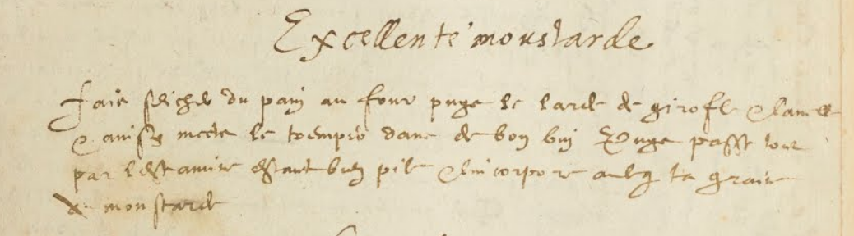
Excellente moustarde
Fais seicher du pain au four puys le larde de girofle & Canelle
& ainsy mects le tremper dans de bon vin Puys passe tout
par lestamine estant bien pile & lincorpore avecq ta graine
de moustarde
Excellent mustard
Dry some bread in an oven, then stick cloves & cinnamon into it and put it to soak in good wine. Then, being well crushed, pass everything through a cloth strainer and incorporate it with your mustard seeds.

Slide 3
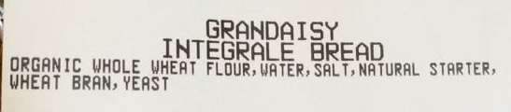
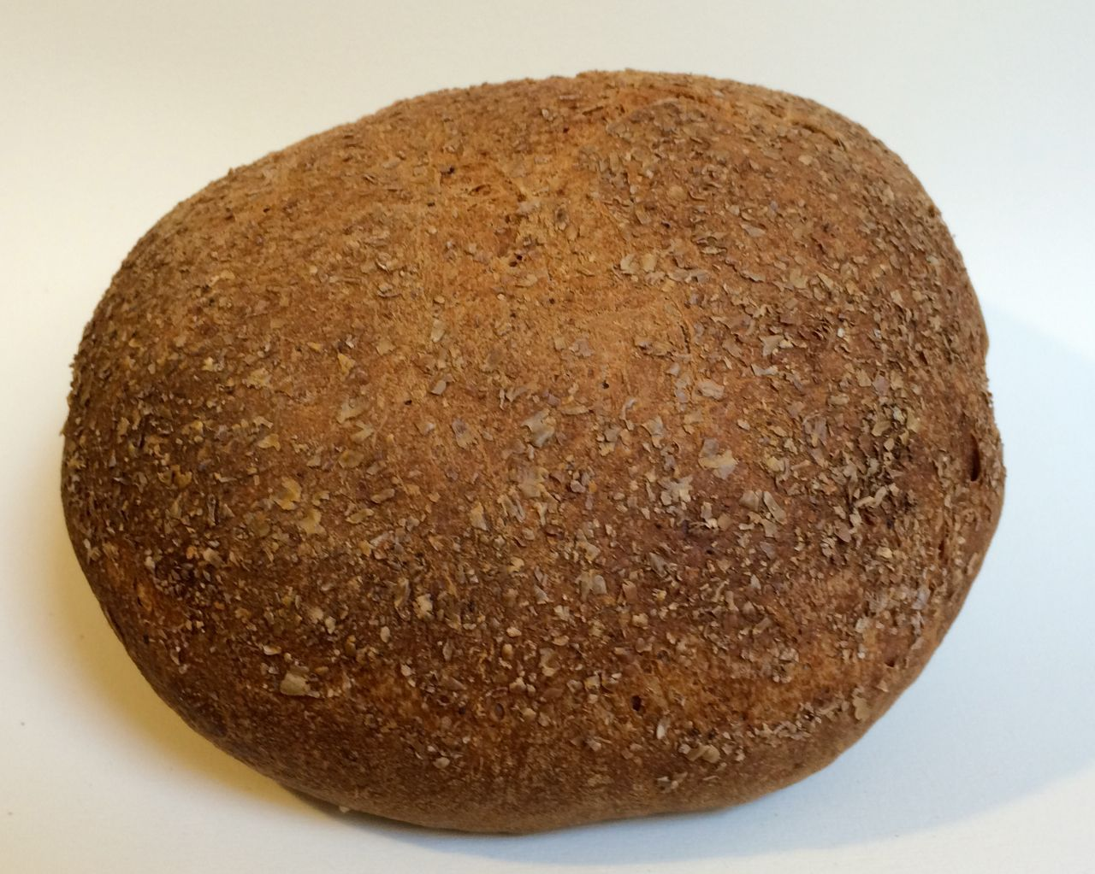
Dry some bread in an oven

Slide 4
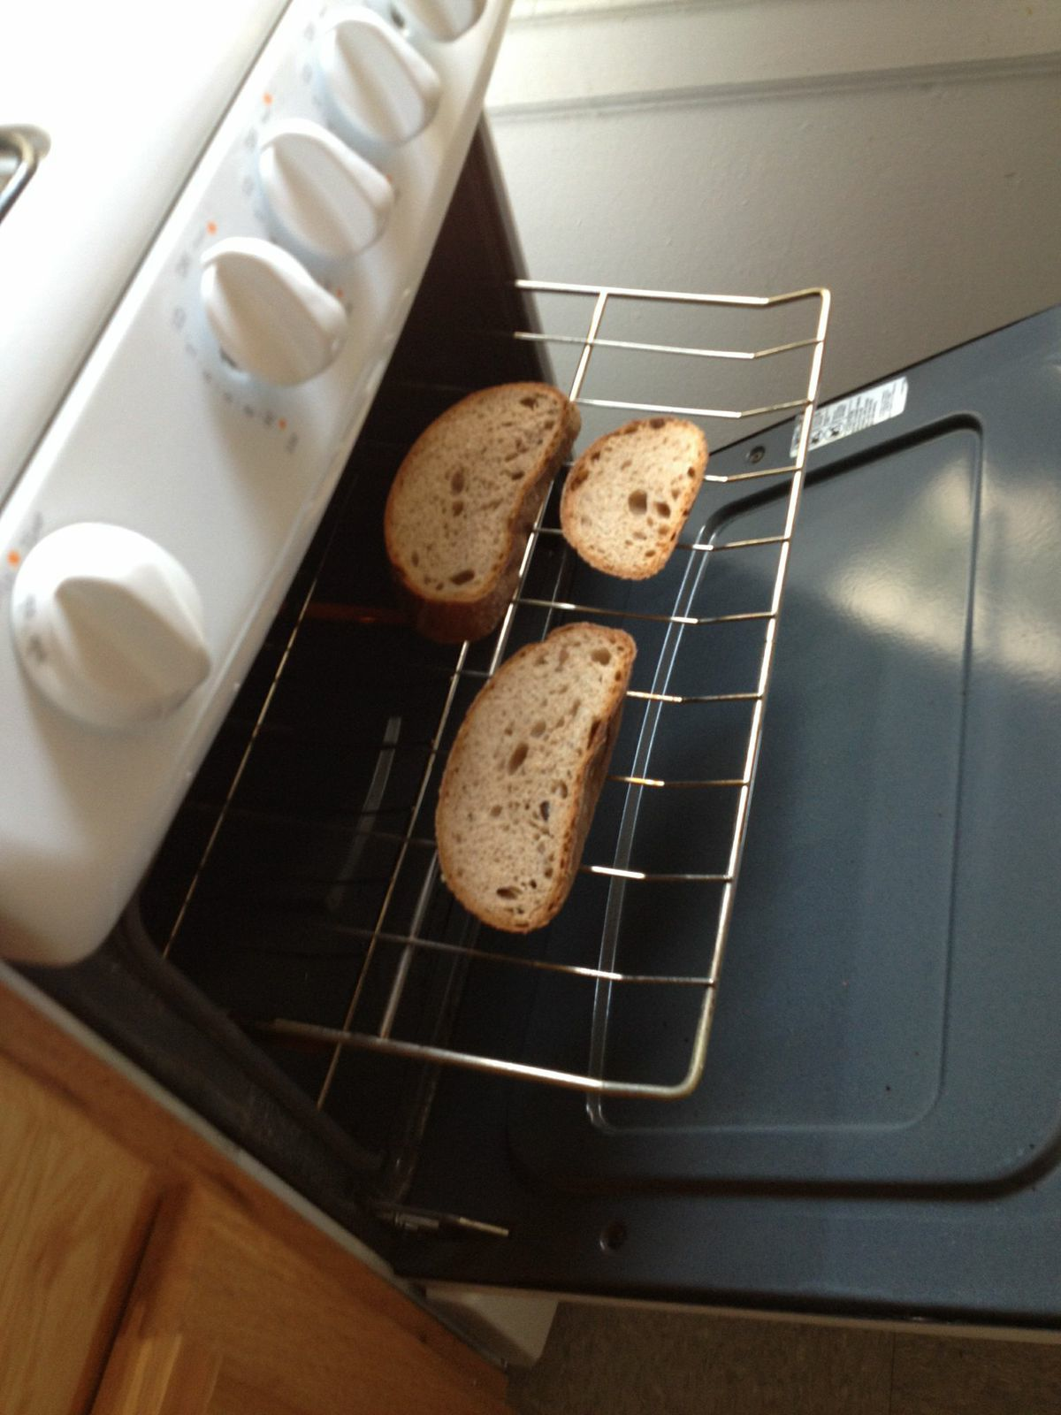
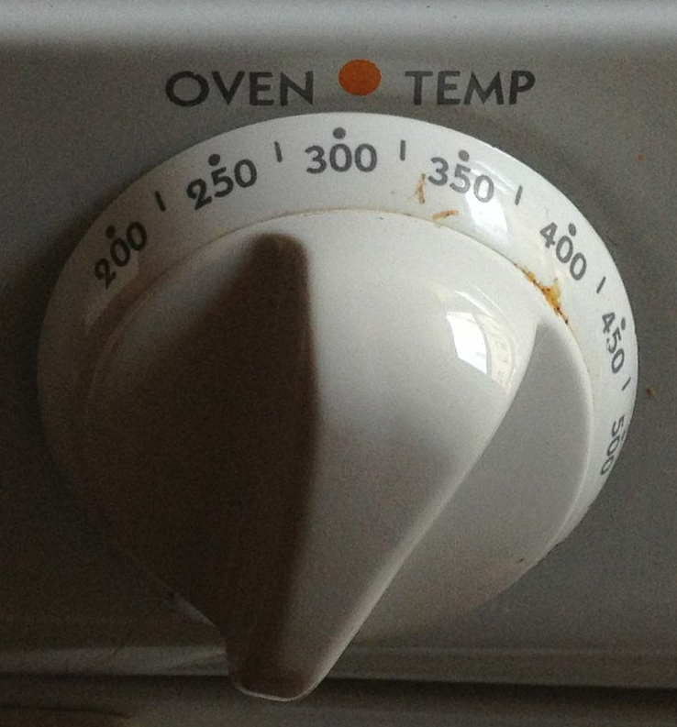
Dry some bread in an oven
18 min
gas oven
*11 ounces whole wheat bread

Slide 5
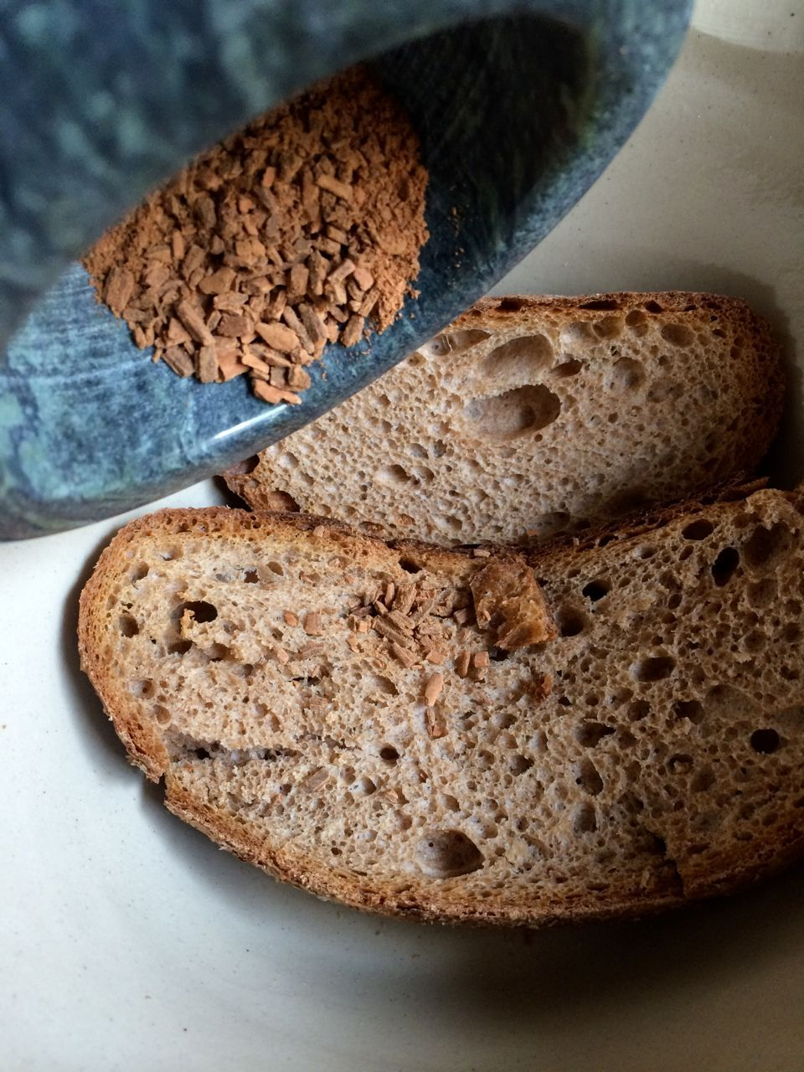
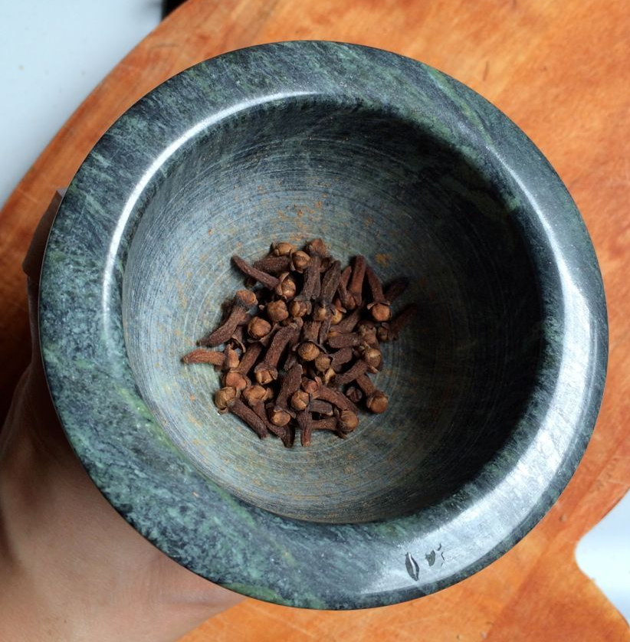
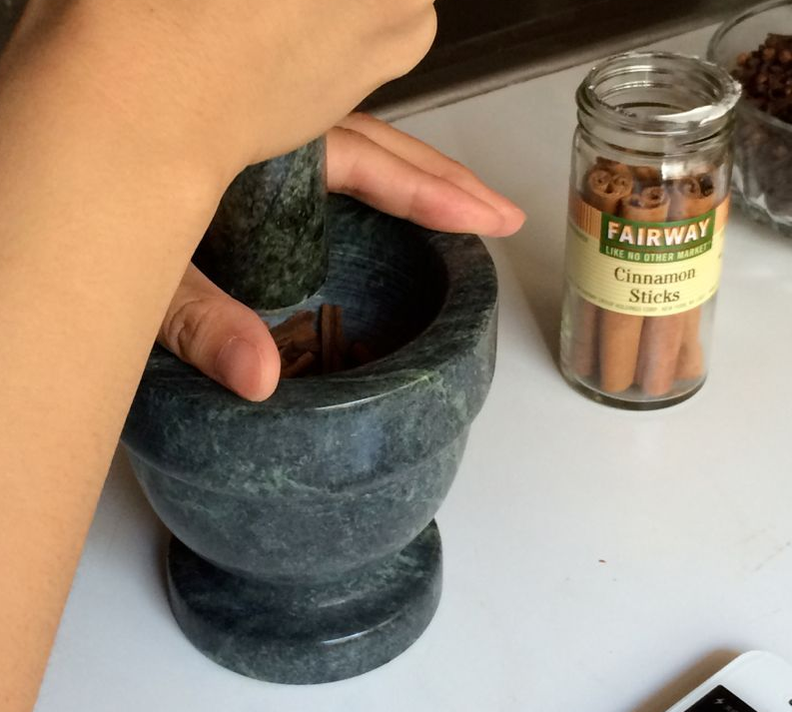
then stick cloves & cinnamon into it
“When you have spices left over from making jelly, claret, hypocras or sauces, grind these with [the mustardseeds] and let it mature…
To make a lot fine hippocras. Take one ounce cinnamon called long cinnamon in sticks, with some pieces of ginger and as much galanga, grind well together.”
—Le Ménagier de Paris, 14th century
*2 sticks cinnamon
*50 cloves

Slide 6

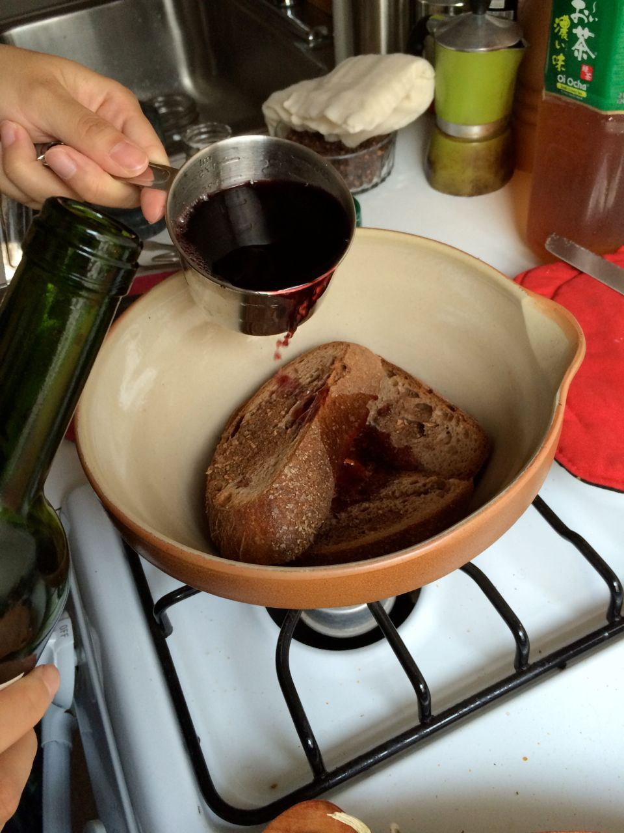
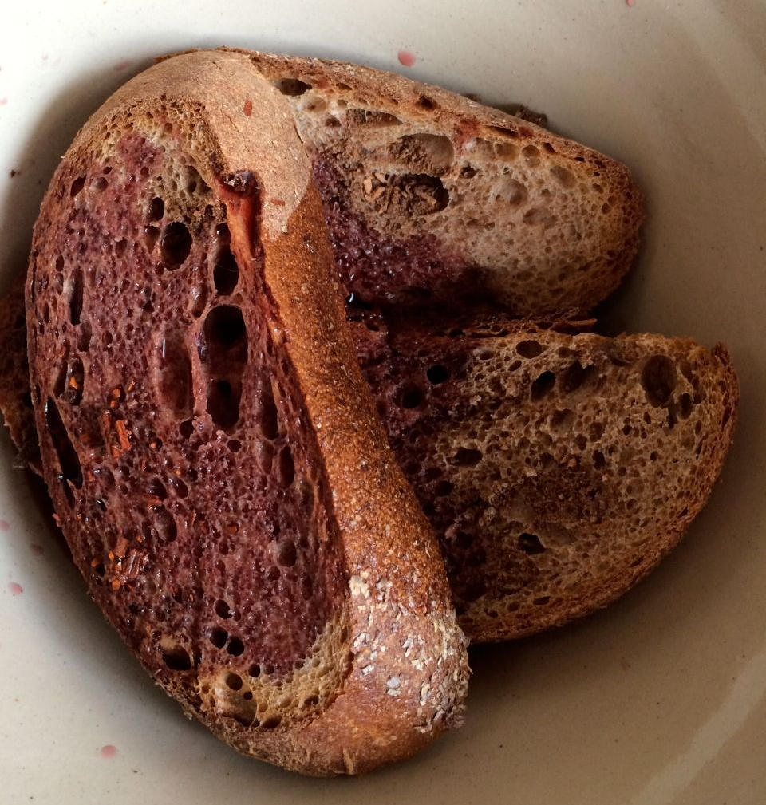
put it to soak in good wine
“If you want to make a supply of mustard that will keep long, make it during the picking-season (of wine grapes) from fresh stum.”
—Le Ménagier de Paris, 14th century
*stum is fresh grape juice, not fully fermented
*1.5 cups Bordeaux

Slide 7
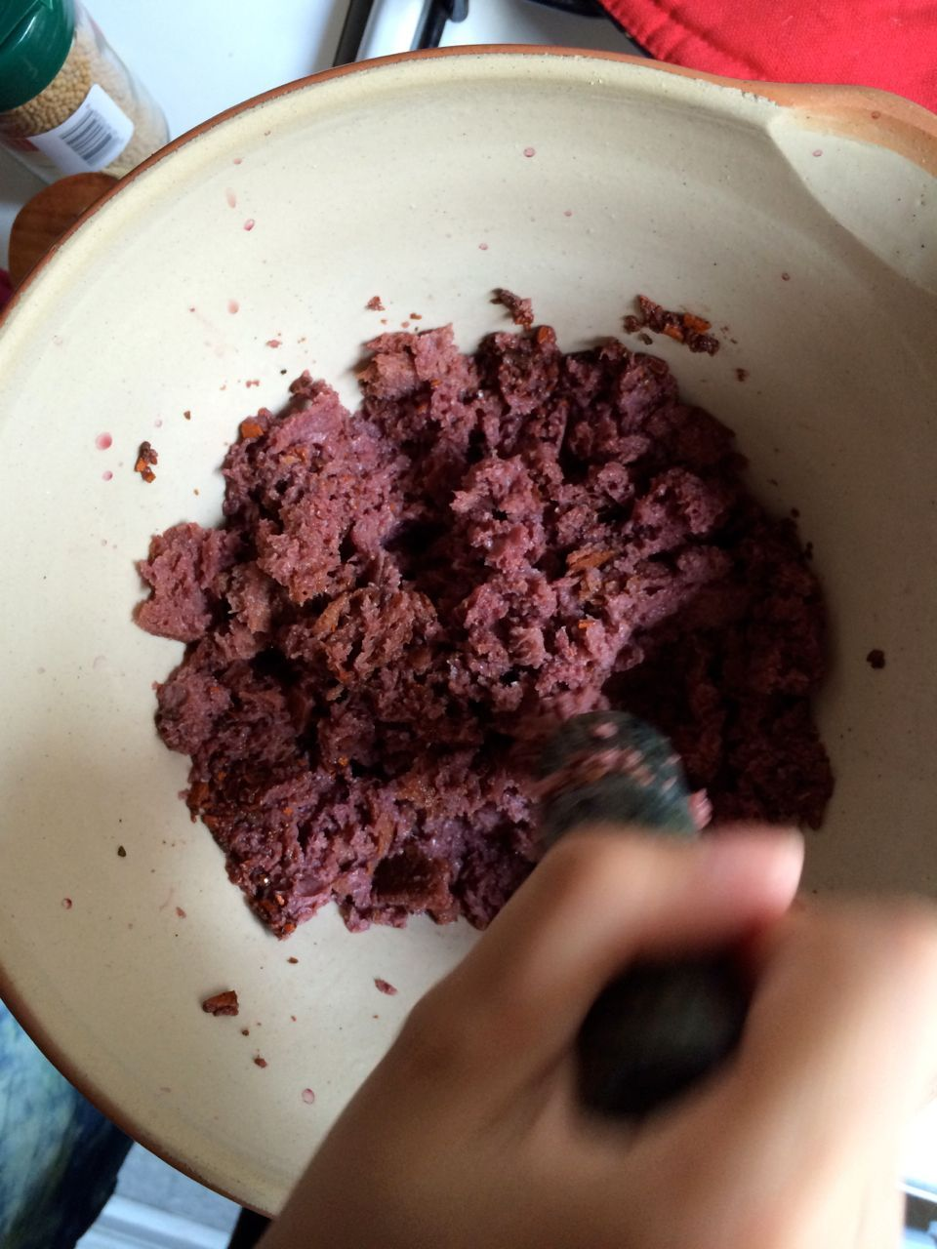
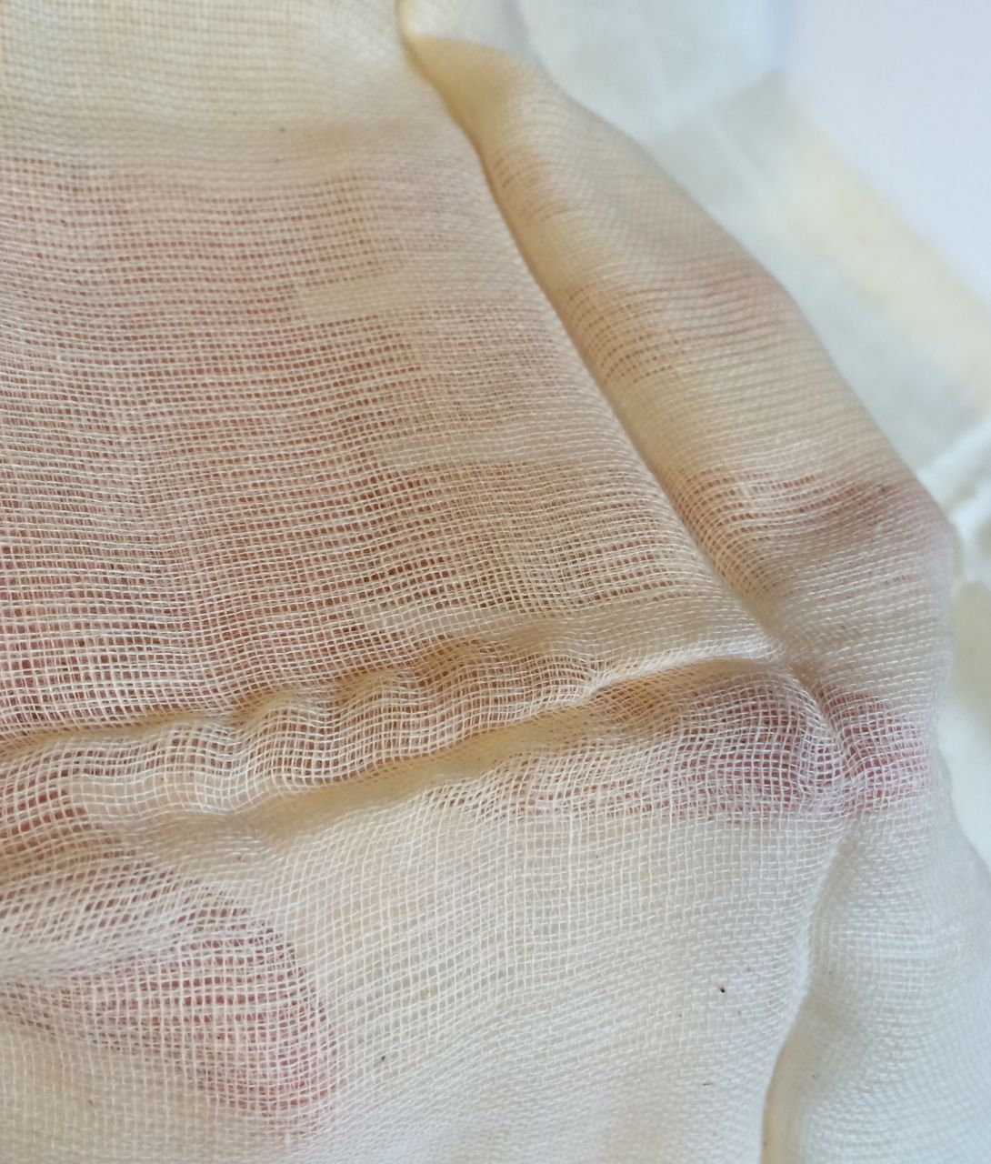
Then, being well crushed, pass
everything through a cloth strainer
Puys passe tout par lestamine estant bien pile
Estamine: f. The stuffe Tamine; also, a strayner, searce, boulter, or boulting cloth; (so called, because made (commonly) of a thinne kind thereof.)
Passer par l’estamine. To straine; to bring unto the touch; to put unto proofe, or tryall; to pass the pikes.
Tamis: m. A searce, or boulter; (also a strayner) made of haire.
—Randle Cotgrave, Dictionarie of the French and English Tongues (London, 1611)
*100% cotton cheesecloth, no additives

Slide 8
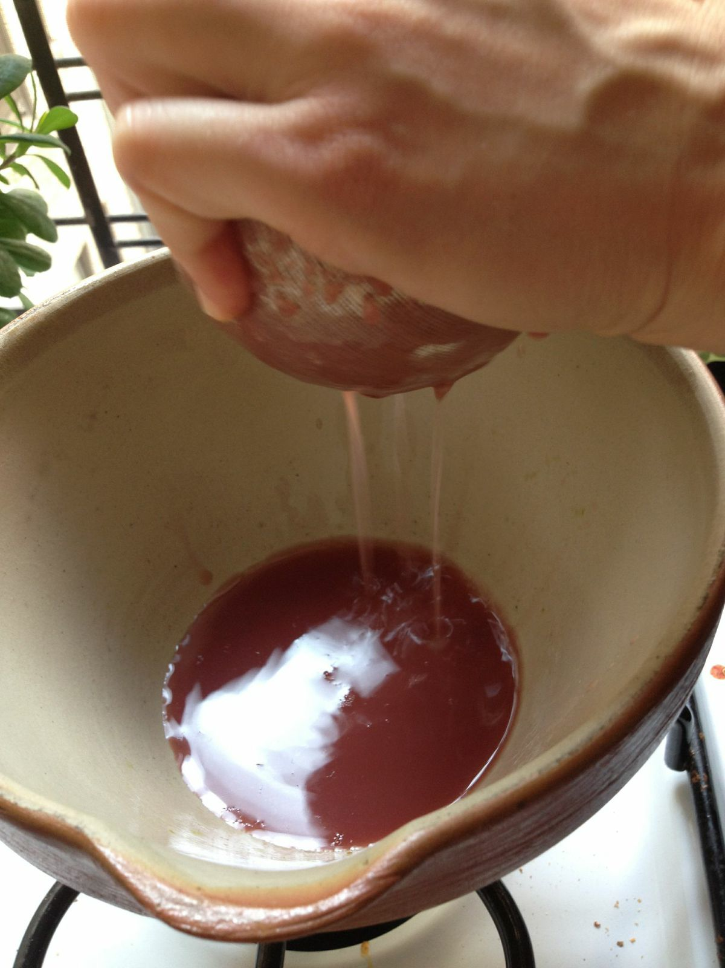
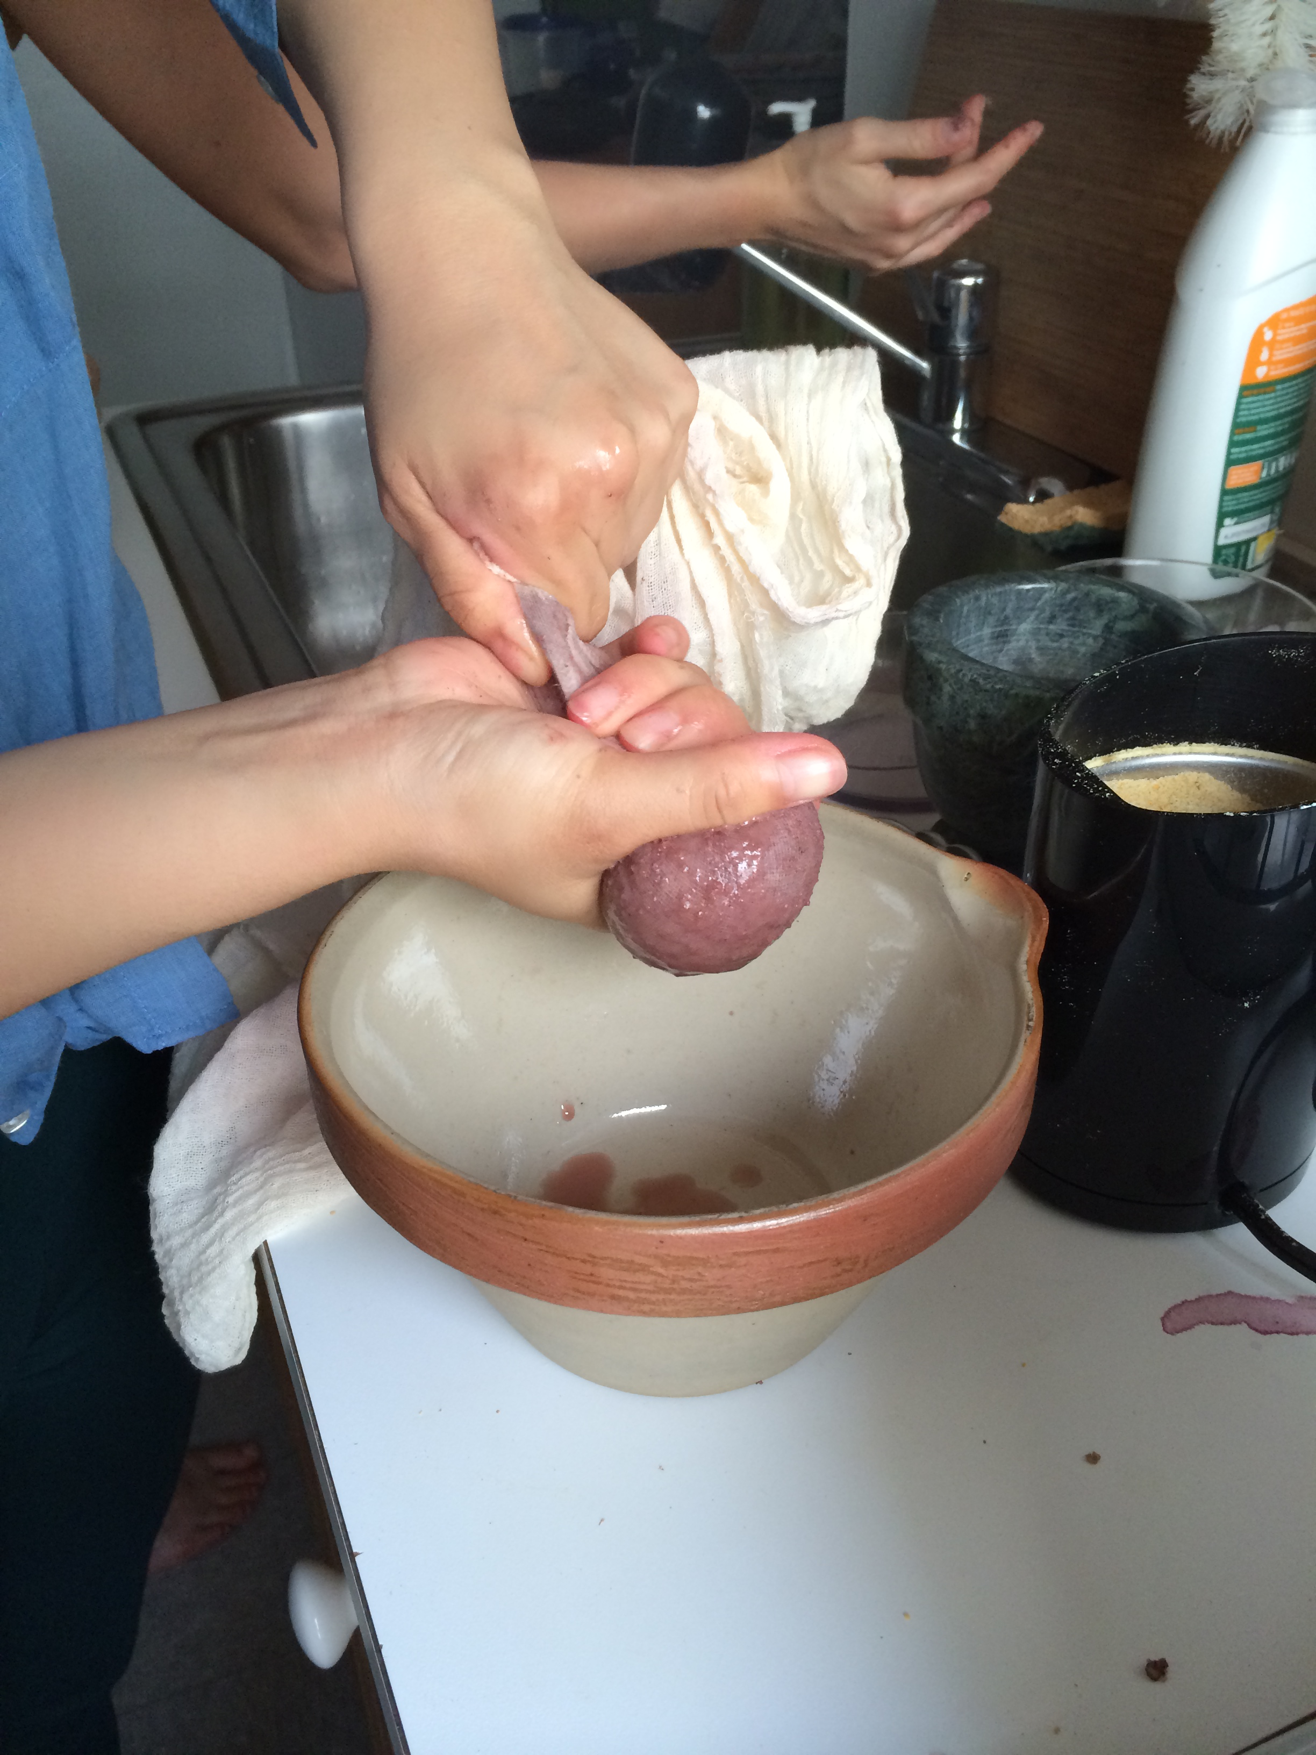
Friday: no soaking,
two layers of cheesecloth
Monday: bread and spices soak in wine for 20 min, one layer of cheesecloth

Slide 9
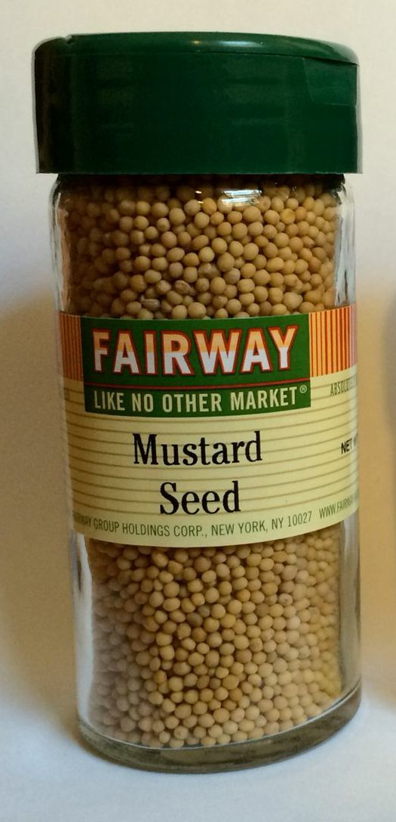
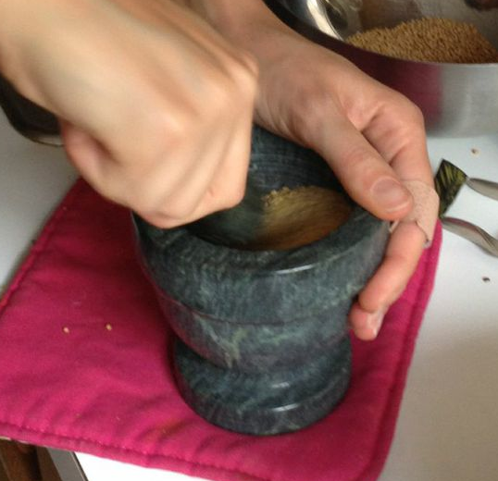
incorporate it with your mustard seeds
“If you want to make mustard in a village (where there is no stum) in a hurry, grind white mustard[seeds] in a mortar, mix with vinagre…”
—Le Ménagier de Paris, 14th century
*1/8 cup white mustard seeds

Slide 10
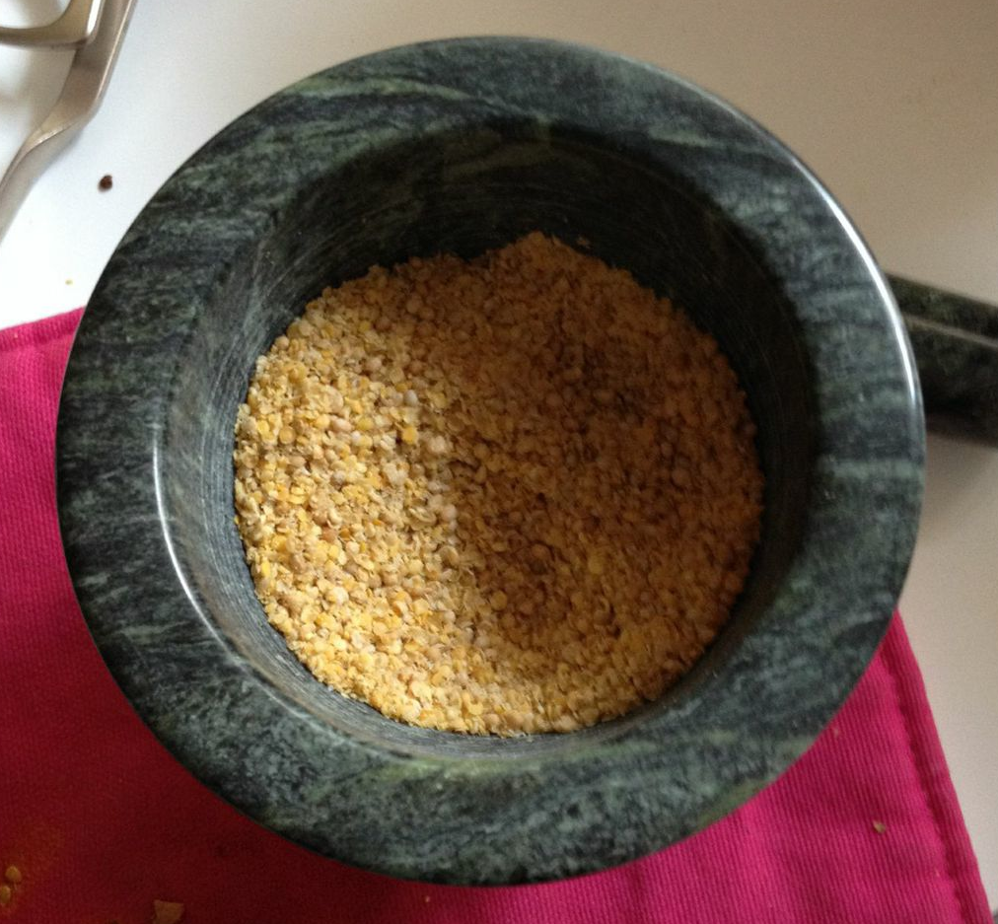
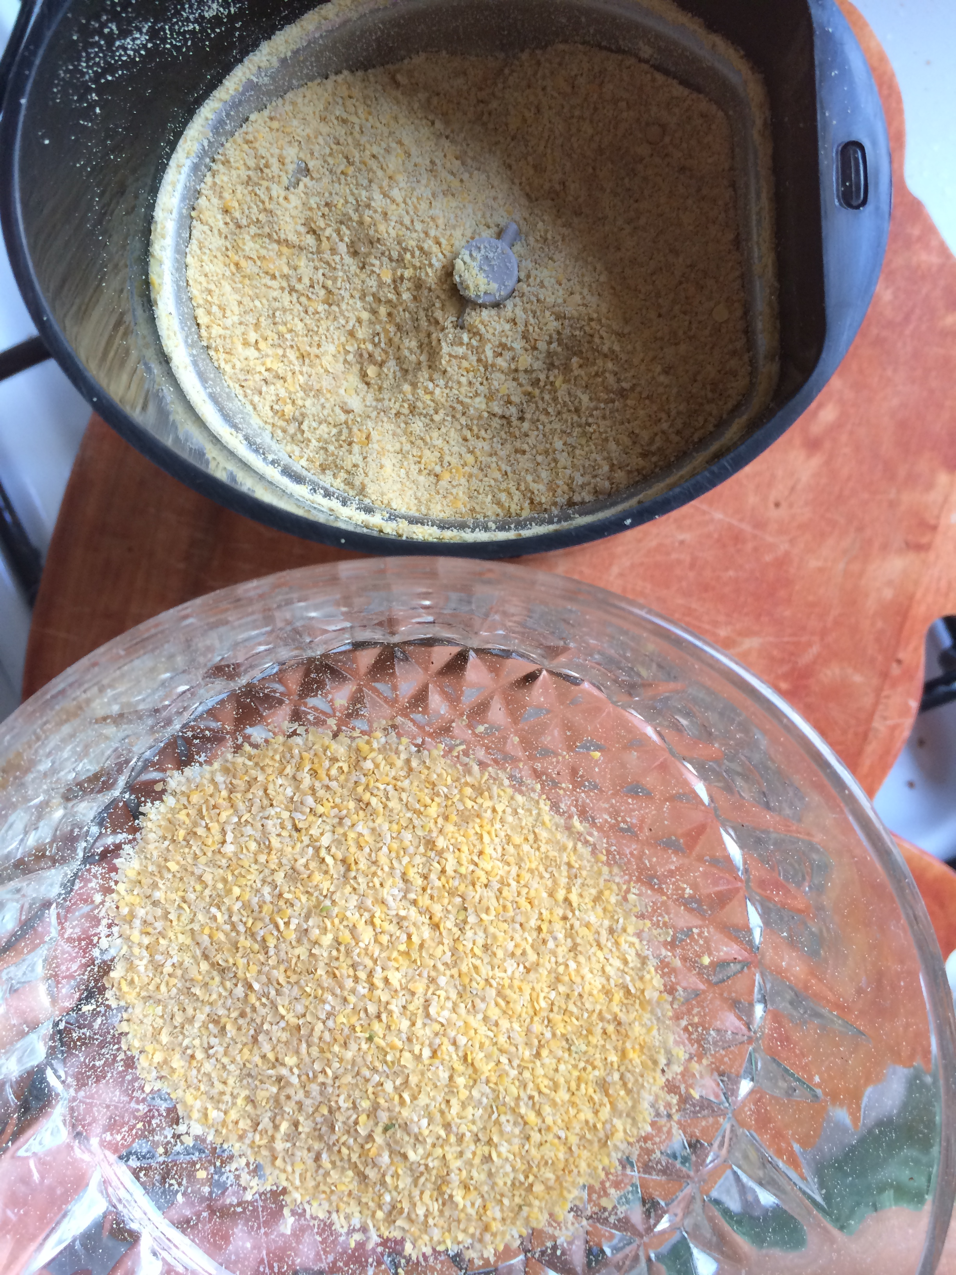
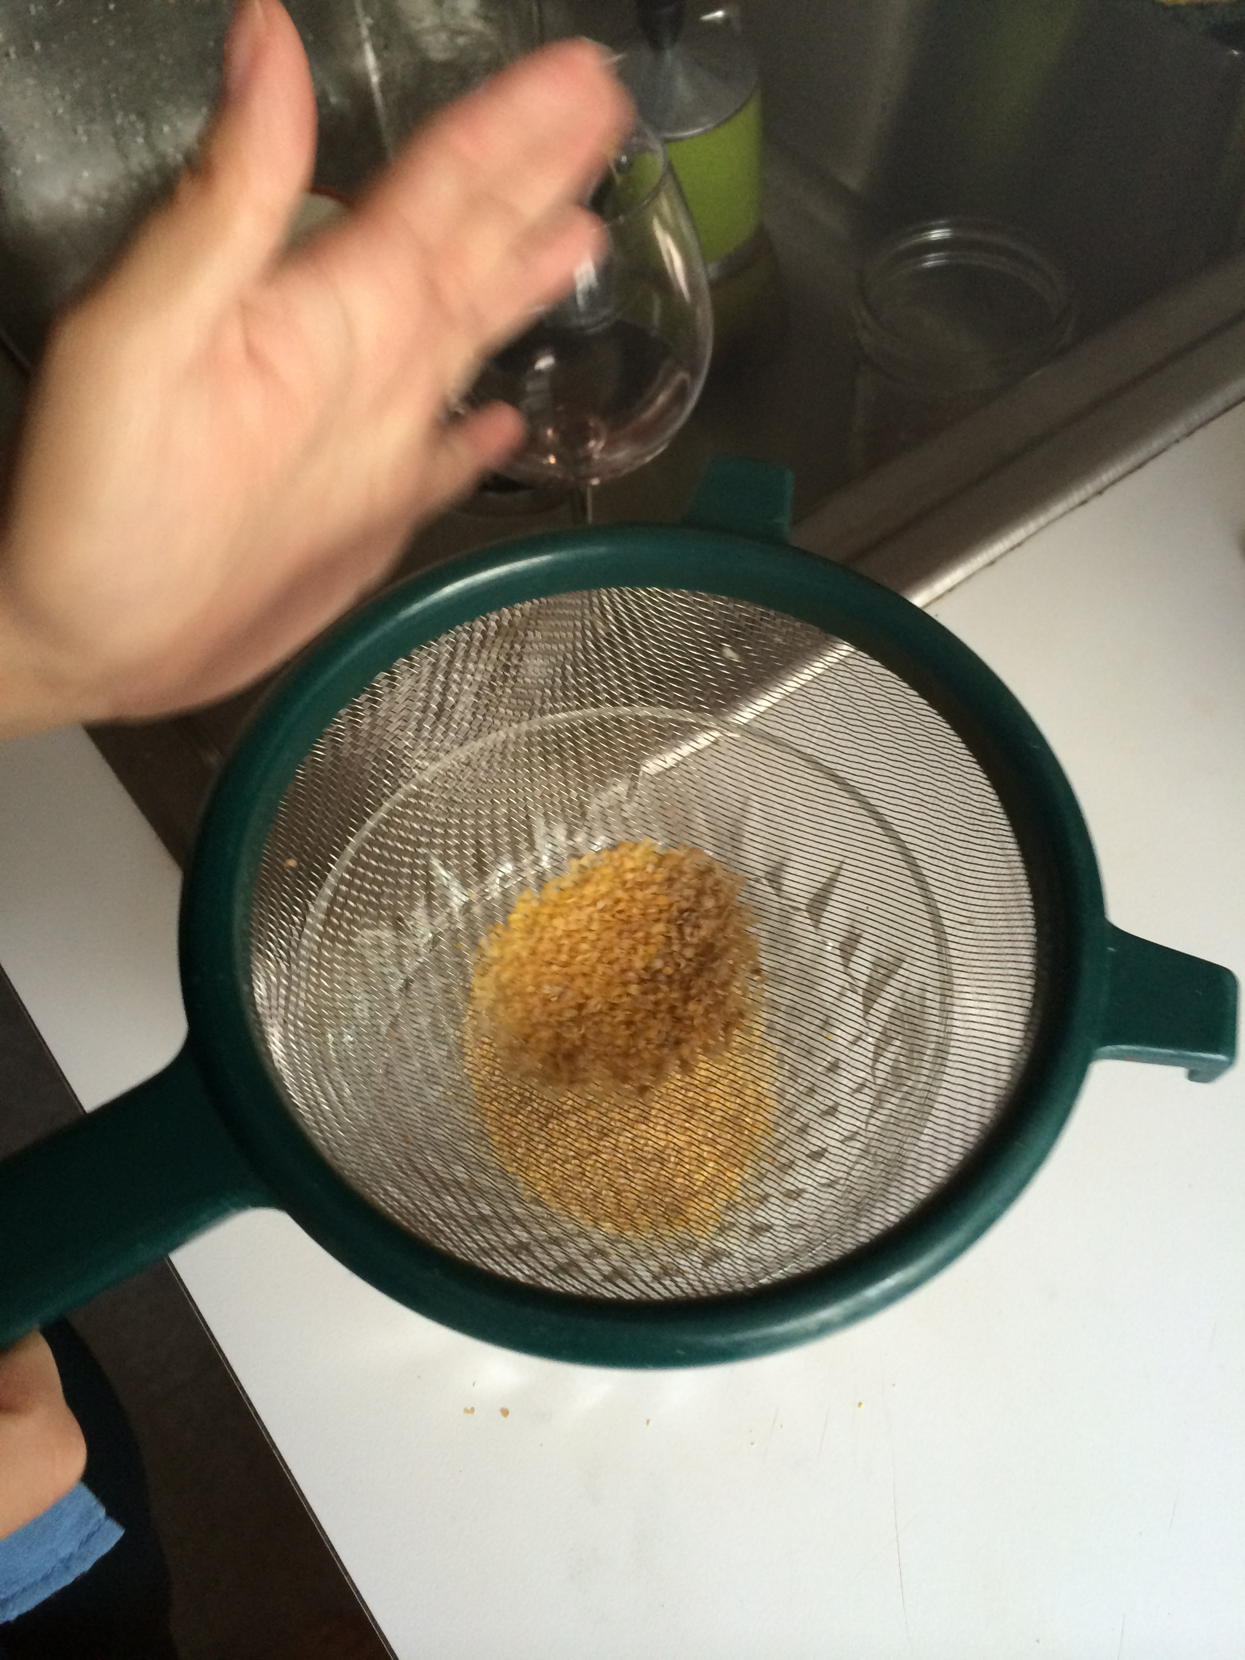
Friday: hand-ground with mortar and pestle, no sifting
Monday: hand-ground with mortar and pestle in smaller batches, sifted through sieve

Slide 11
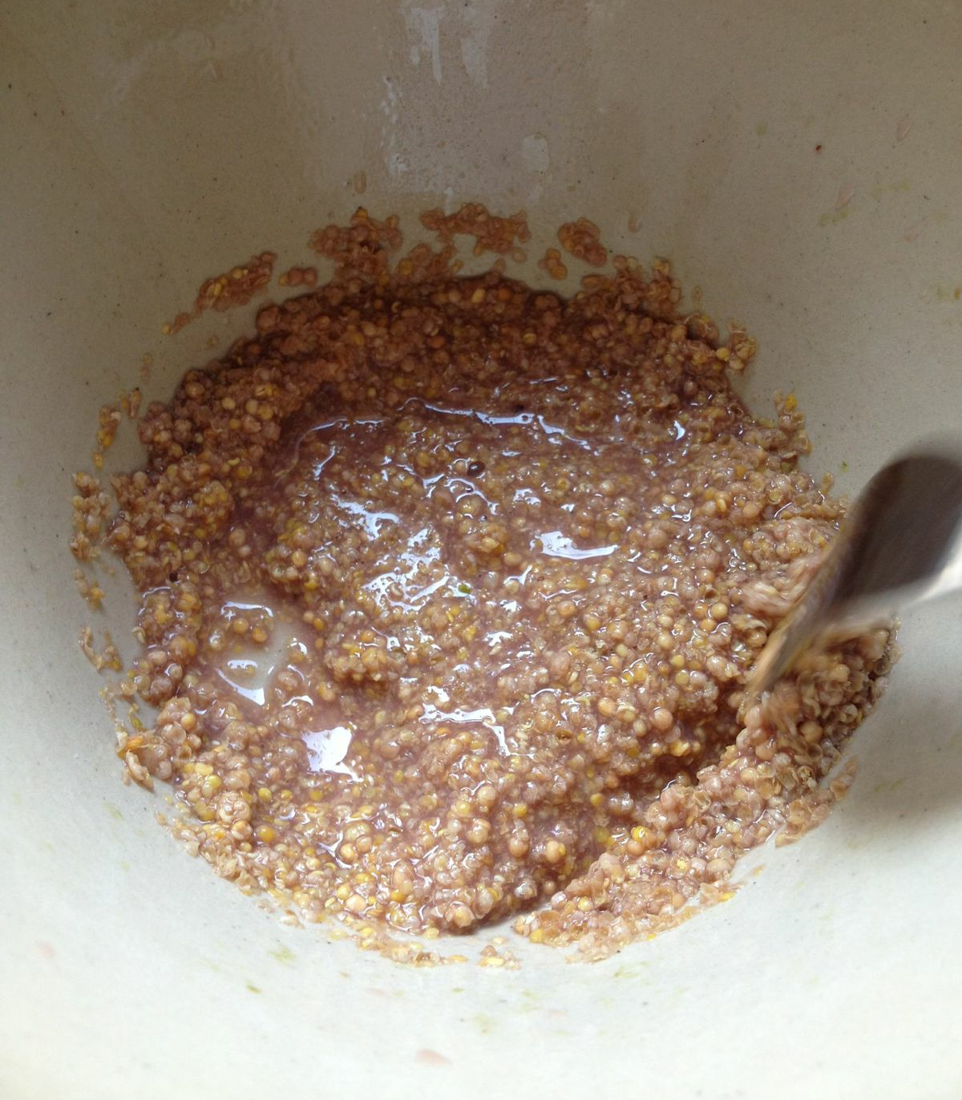
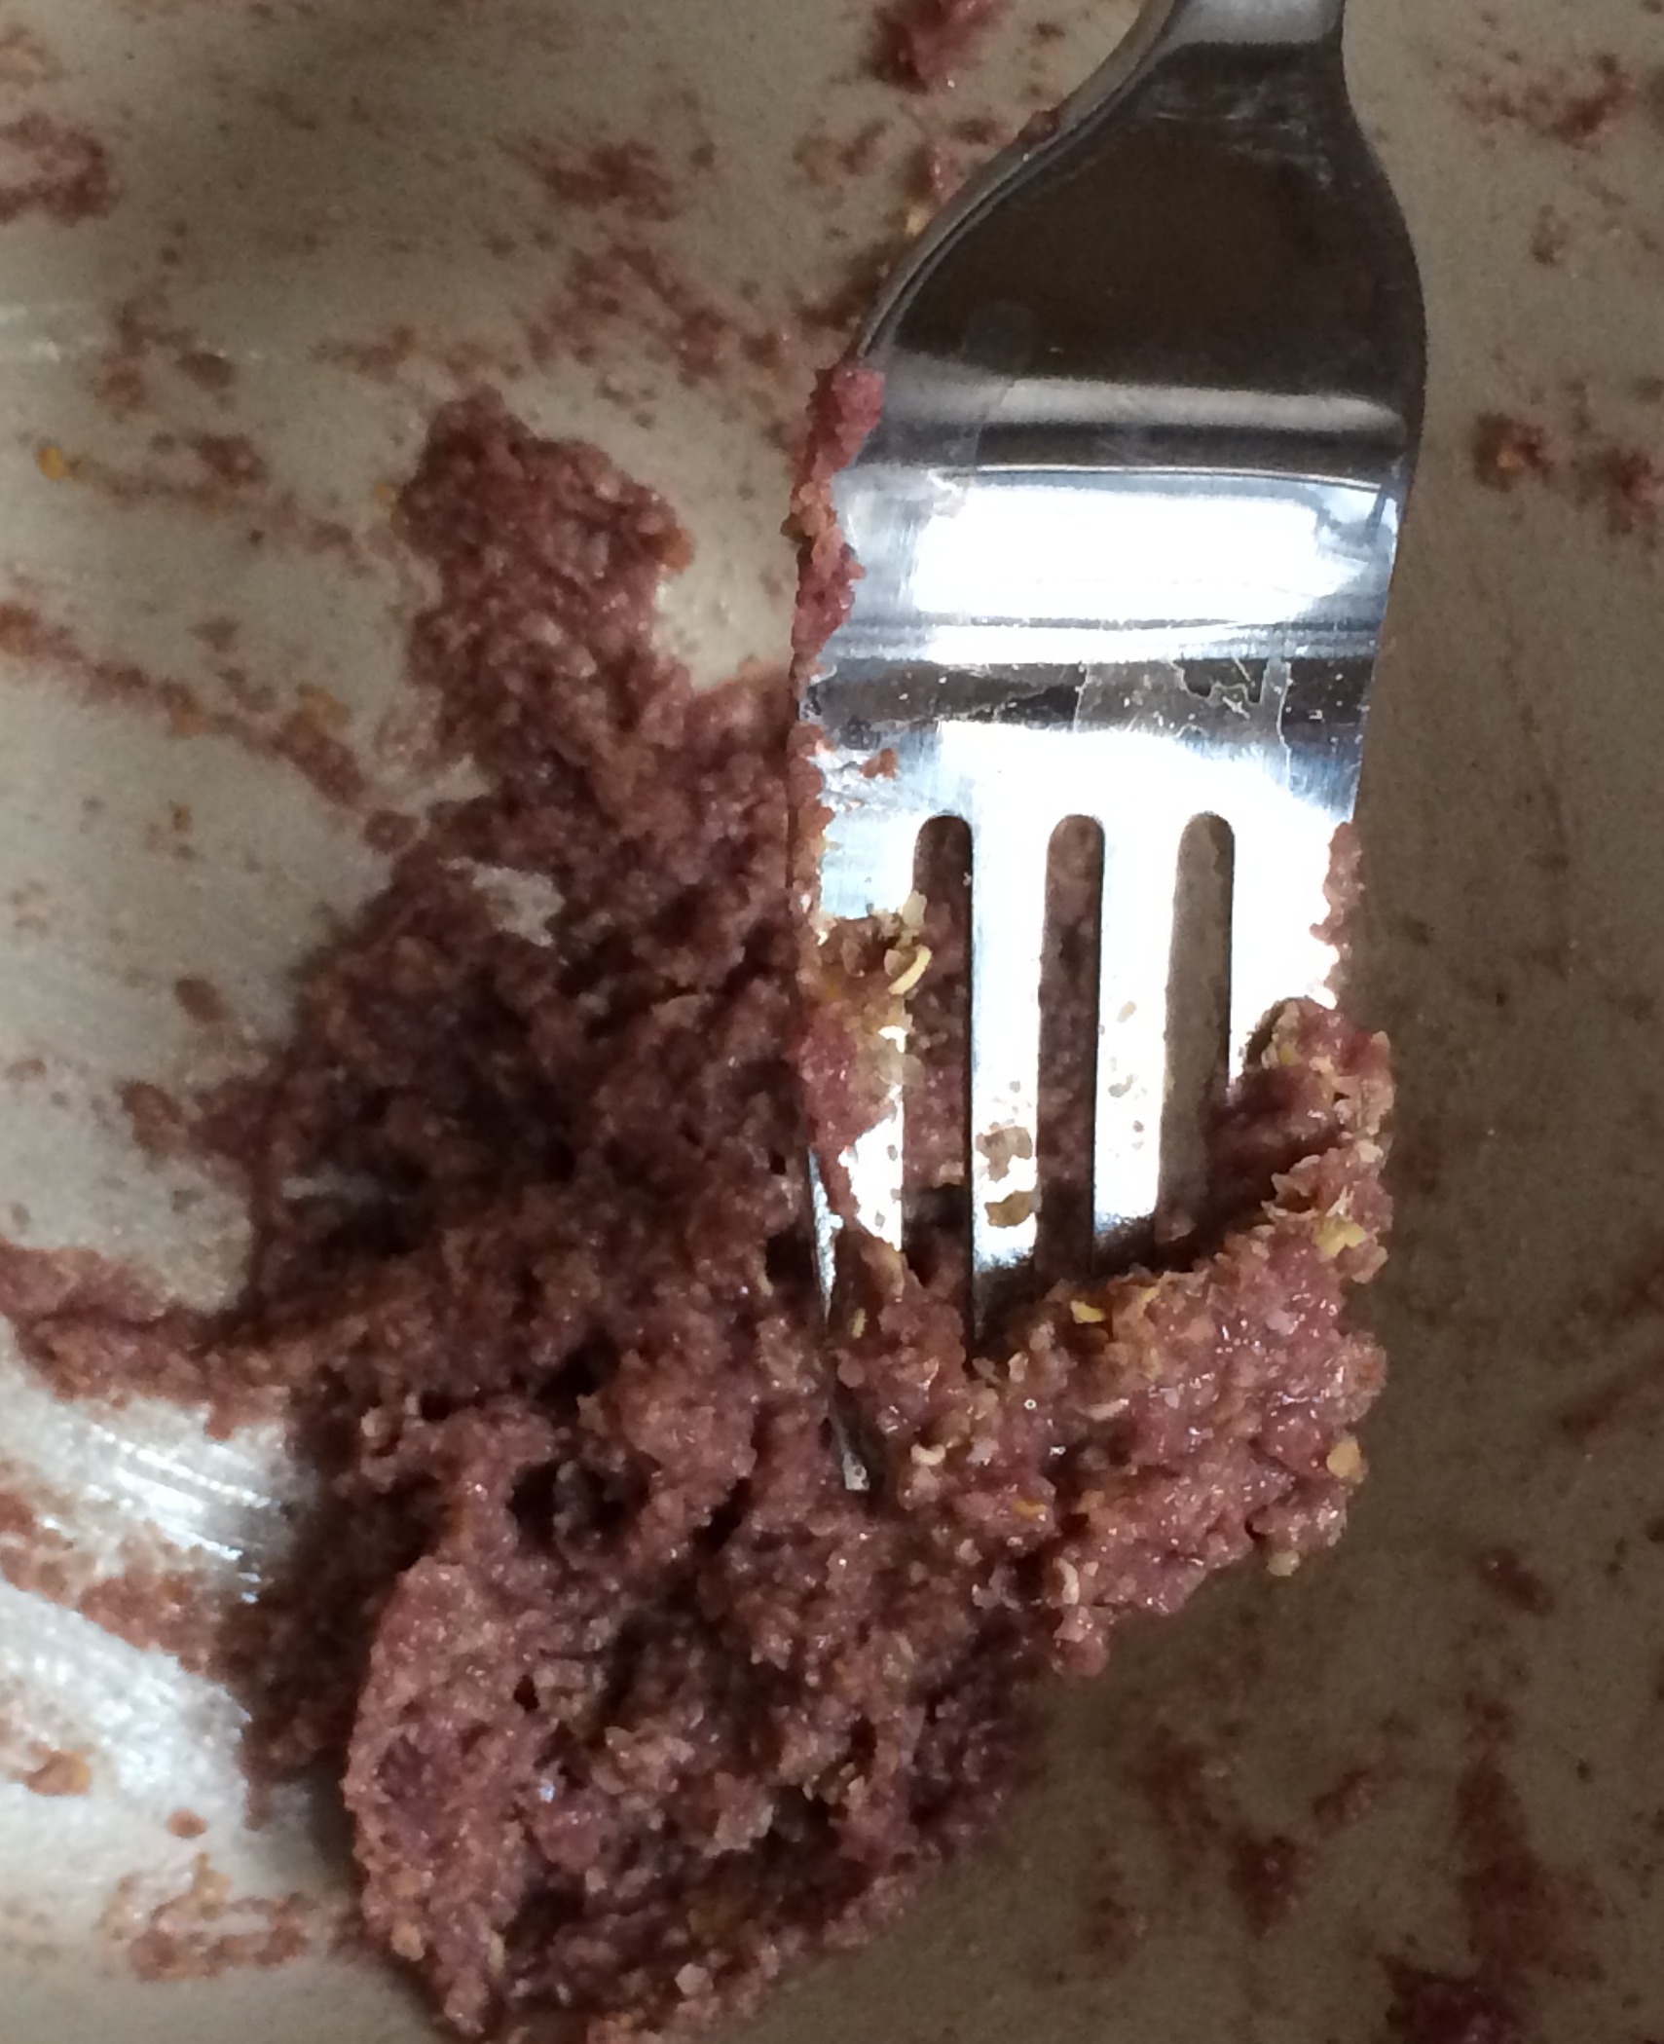
Friday:
1/8 cup ground mustard seeds
Monday:
1/16 cup ground mustard seeds

Slide 12
What makes an excellent mustard?
The author refers to mustard’s density elsewhere in the manuscript:
“And stir it with your palette so that it all becomes like a thick sauce or light mustard.” (121v casting in silver)
“…then apply a thick coat (as thick as mustard or a little bit thicker) over the medal…” (89v white glassmakers’ sand mixed with ammonia salt)
“…adjust it with such attentiveness that, while mixing it vigorously and wetting it quickly with a wooden spoon, it does not become thicker than mustard…” (113v sand casting)

Slide 13
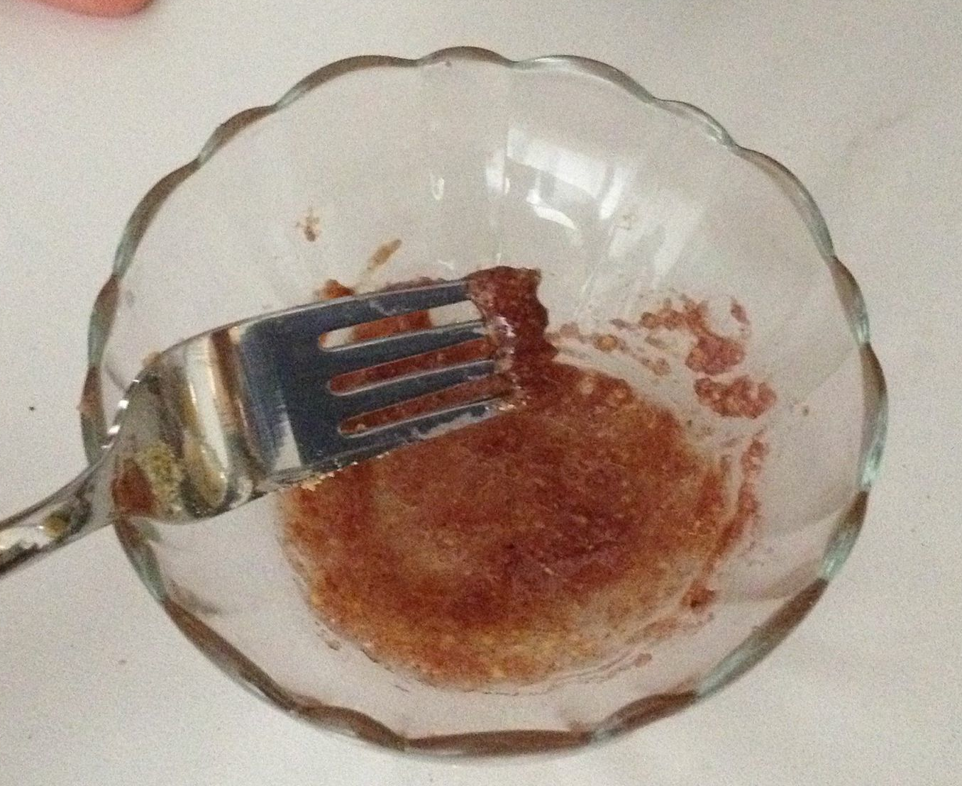
How can we make our mustard taste better?
“Sulphur oil bites and is corrosive, but it is softens by the clove oil [lhuile] and rose honey.” (46r for the teeth, some sulphur oil)
“It is true that it has a bad smell but you can add some rosat honey and cinnamon or clove oil.” (47r for teeth)
“When the wine is enough burned, heat it a bit more and add a few cloves and enough sugar.” (71r sweet and burned wine)

Slide 14
Excellent mustard
Dry some bread in an oven, then stick cloves & cinnamon into it and put it to soak in good wine. Then, being well crushed, pass everything through a cloth strainer and incorporate it with your mustard seeds.
Mustard
11 oz bread, whole wheat or white
2 sticks cinnamon
50 cloves
1.5 cups of wine, with about half cup extra
1/16 cup yellow mustard seeds
Preheat oven to 300 F. Slice bread to 1-1 ½-in thick slices. Place bread directly on oven tray and leave until dry, about 18 min. In the meantime, grind cloves and cinnamon roughly. Grind mustard seeds finely, and strain through tight sieve to remove large husks. Remove bread from oven, add cinnamon and clove, add 1.5 cups sweet red wine, and leave to soak for 20 min. Combine all ingredients in a large bowl and crush together. Strain through cotton cheesecloth and combine resulting paste with ground mustard. Serve with honey.

