Slide 1
A Tart of hippes
By Emily Boyd and Jef Palframan
HRR Assignment #1
HIST G8906 – Craft and Science

Slide 2
Our Procedure
Establishing the Purpose and Context
Considering the Recipe and Ingredients
Familiarization with Equipment and Technologies
Defining Metrics/Units of Measure
Successes and Failures Learning Experiences
Recipe Update
Conclusions

Slide 3
Establishing the Purpose and Context
Purpose of this Experiment:
Reconstruction of a late 16th and early 17th century dish;
understand and experience the challenges of reconstruction exercises;
develop and refine procedure for conducting reconstructions from historical recipes; and
Capture tacit knowledge contained in the recipe and other information upon which some conclusions regarding cooking in the early modern era could be formed.

Slide 4
Establishing the Purpose and Context
Thomas Dawson (Author)
No information on him in the Oxford Dictionary of National Biography; genealogical search indicates that a Thomas Dawson was born in 1580 in Cottingham, Yorkshire, England and died in 1620. No corroborating evidence if this is the same person, however the death dates match.
Possible reasons for writing this book:
wanted to profit from the exploitation of an untapped market among married women for cookbooks;
wanted to cultivate his image; or
had ideas about the role of cookery in marriage that he wanted to promote.
This book was reprinted in 1596 and in 1610. He also wrote another part to ‘the good housewives’ in 1597 and ‘A book of Cookery’ which was published in 1620 and reprinted in 1629 and 1650.

Slide 5
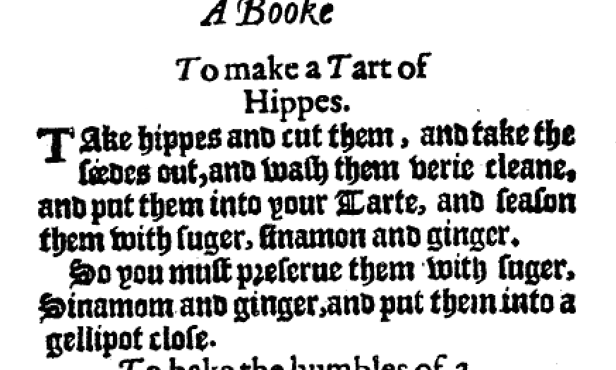
Considering the Recipe and Ingredients
To make a Tart of Hippes
Take hippes and cut them, and take the
Seedes out, and wash them verie cleane,
and put them into your Tarte, and season
them with suger, sinamon and ginger.
So you must p[r]eserve them with suger,
Sinamom and ginger, and put them into a
gellipot close.
Thomas Dawson, The good husvvifes ievvell VVherein is to be found most excellent and rare deuises for conceits in cookerie … (London, 1587), p. 18.

Slide 6
Considering the Recipe and Ingredients
Sir Hugh Plat. Delights for Ladies. (London, 1602).

Slide 7
Considering the Recipe and Ingredients
Confirming Terminology and Phrasing:
‘Hippes’:
defined as the fruit of a rose, today known as rosehips;
‘put them into your Tarte’:
‘into’ could indicate an enclosed tart (like a pie) or an open faced tart;
we decided, based on the excess of dough and the two versions of tarts that we had been seeing, to attempt both versions;
‘cut them, and take the Seedes out, and wash them verie cleane’
indicates that the hips are freshly picked
‘and put them into a gellipot close’
what constitutes ‘them’ in this phrase?; decided upon ‘them’ being the left over rosehips themselves that had been seasoned.

Slide 8
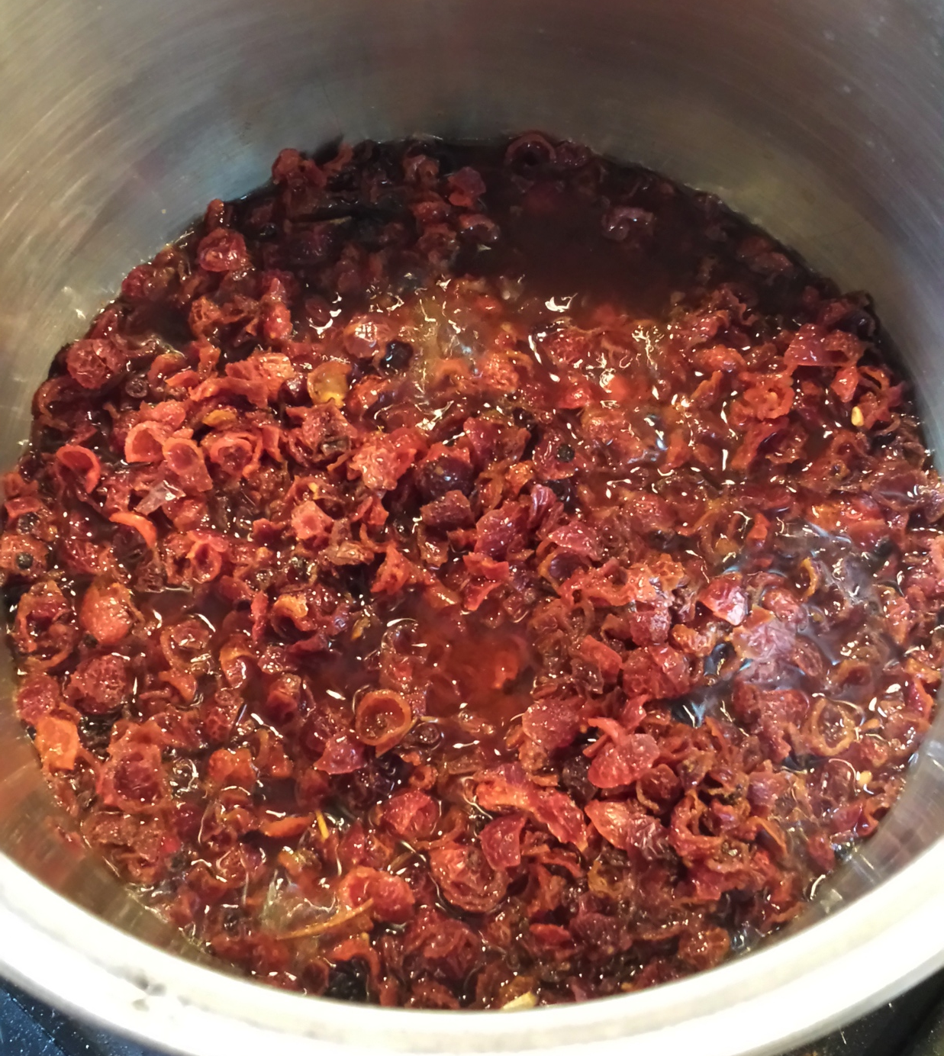
Considering the Recipe and Ingredients
Ingredients:
Hippes (or Rosehips):
The search for ‘fresh’ rosehips proved difficult. The fresh ones we were able to obtain would arrive to late. The only hips that we could obtain in time were dried and came from Chile. These were ‘reconstituted as best we could by slowly adding hot water until they obtained the proper consistency, as far as we could judge it.

Slide 9
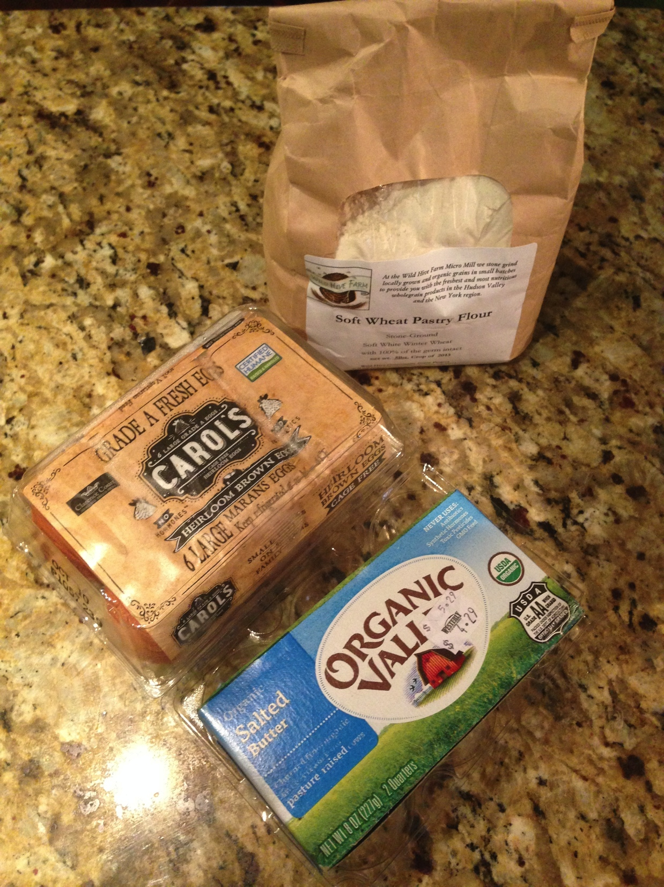
Considering the Recipe and Ingredients
Ingredients (cont.)
Flour:
100% wheat germ, finely stone-milled flour from an independent local farm;
Eggs
Local organic cage-free;
Butter
organic salted butter.
Sugar
Store-bought name brand refined white sugar (not pictured)

Slide 10
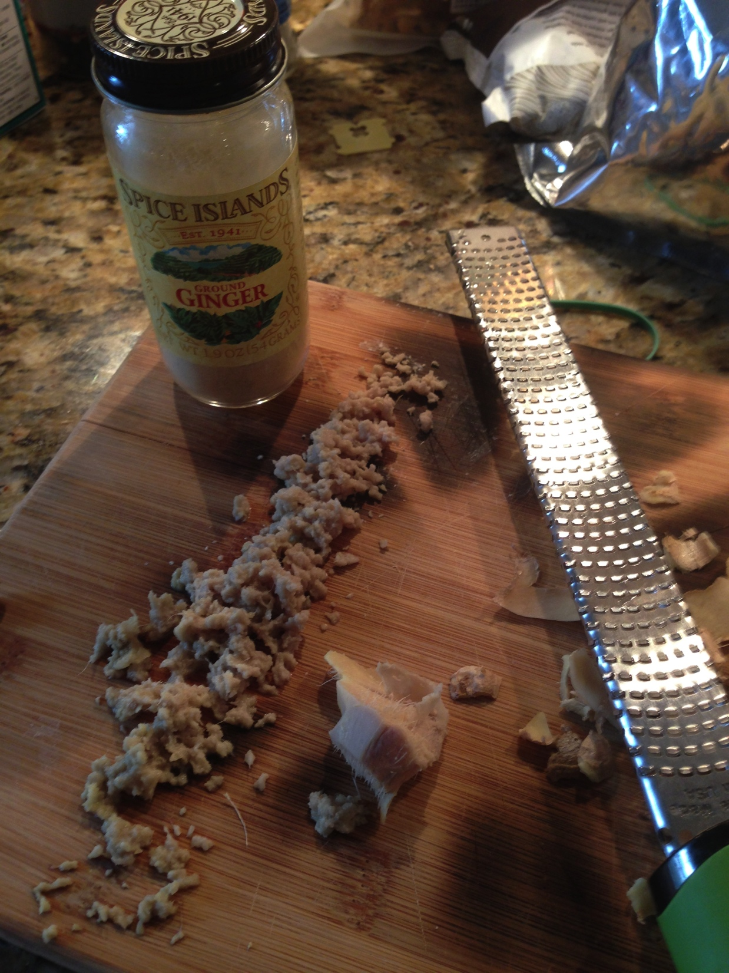
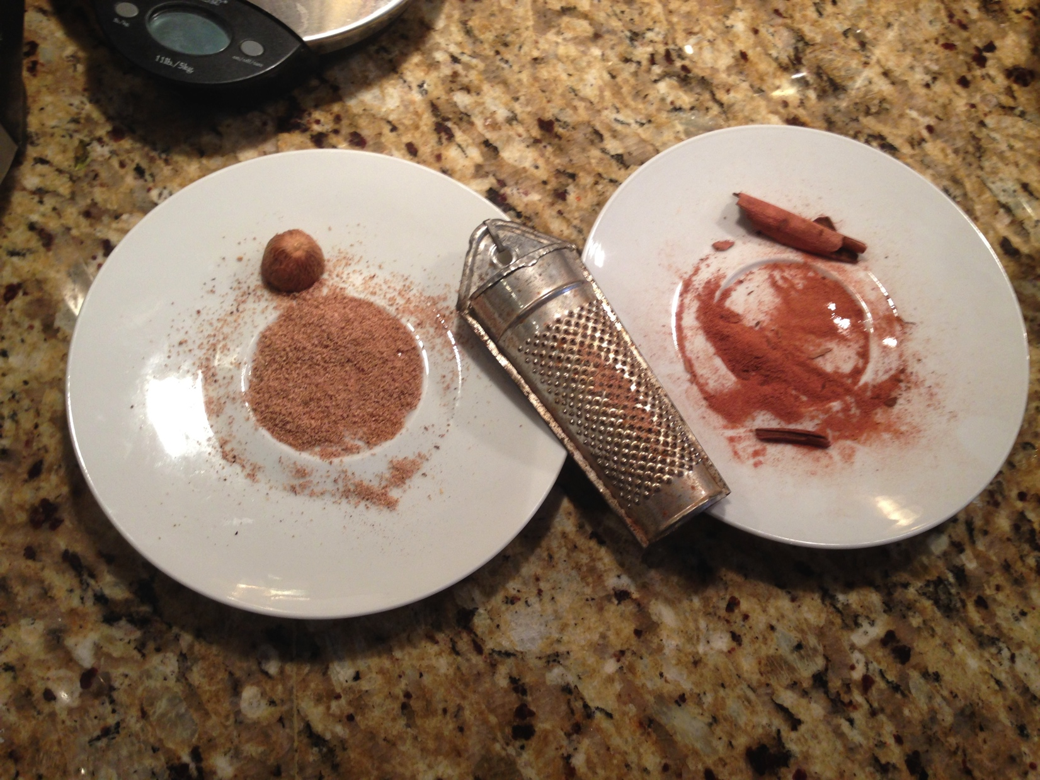
Considering the Recipe and Ingredients
Ingredients (cont.)
Ginger:
Fresh, or dried and ground;
Nutmeg (?):
Whole grated;
Cinnamon
Whole grated.

Slide 11
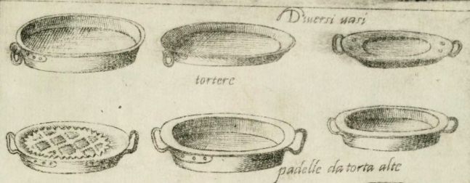
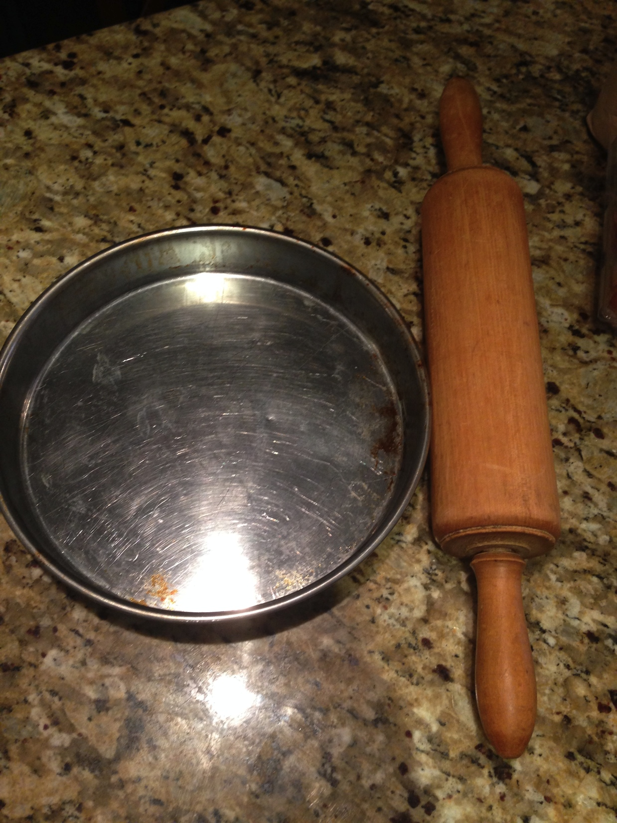
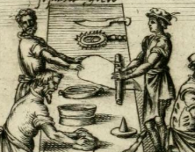
Familiarization with Equipment and Technologies
Cooking dish
Rolling Pin
Graters
Notes:
All from Opera

Slide 12
Familiarization with Equipment and Technologies
Heat Generation
Wood and/or Charcoal assumed, but avoided due to safety and availability concerns;
Utilized a natural gas oven in an apartment.
Notes:
All from Opera

Slide 13
Defining Metrics/Units of Measure
The primary recipe specifies no measurements, however the secondary recipe for the dough does:
“a quart of the finest flower”;
“a little cold water”; and
“small peeces of butter as big as Nuts”.

Slide 14
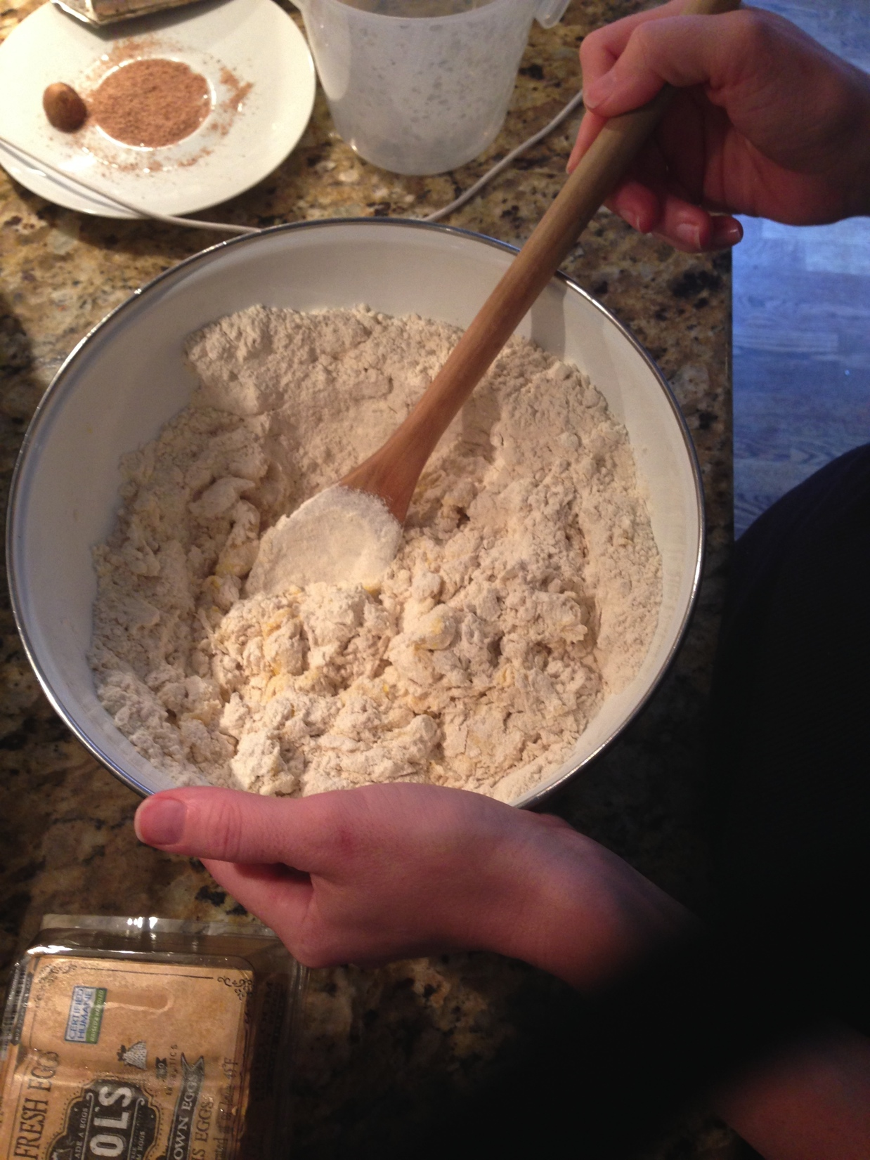
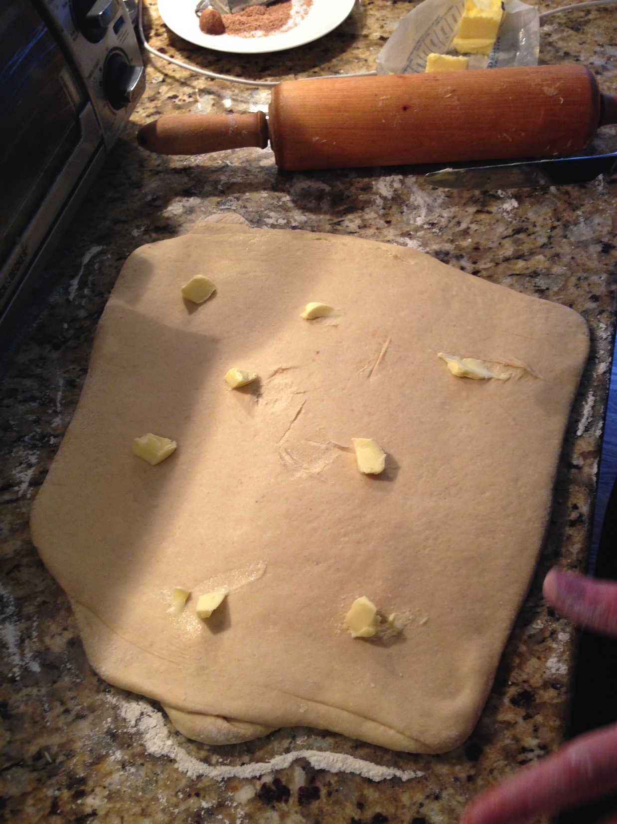
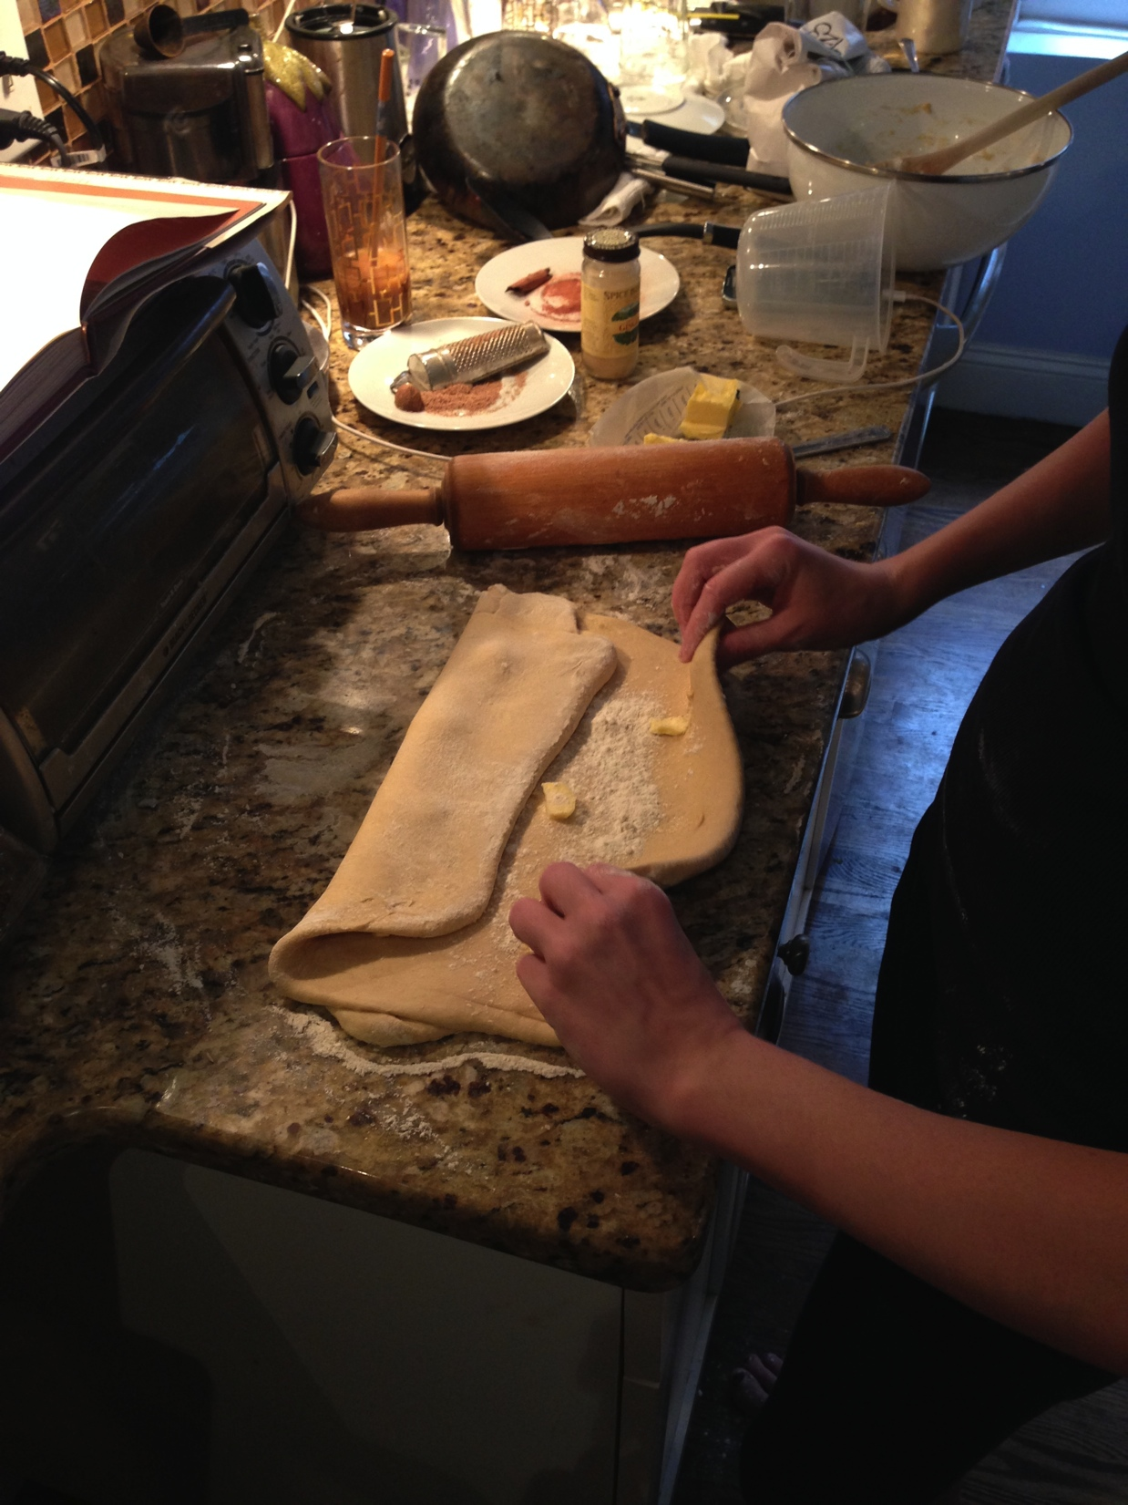
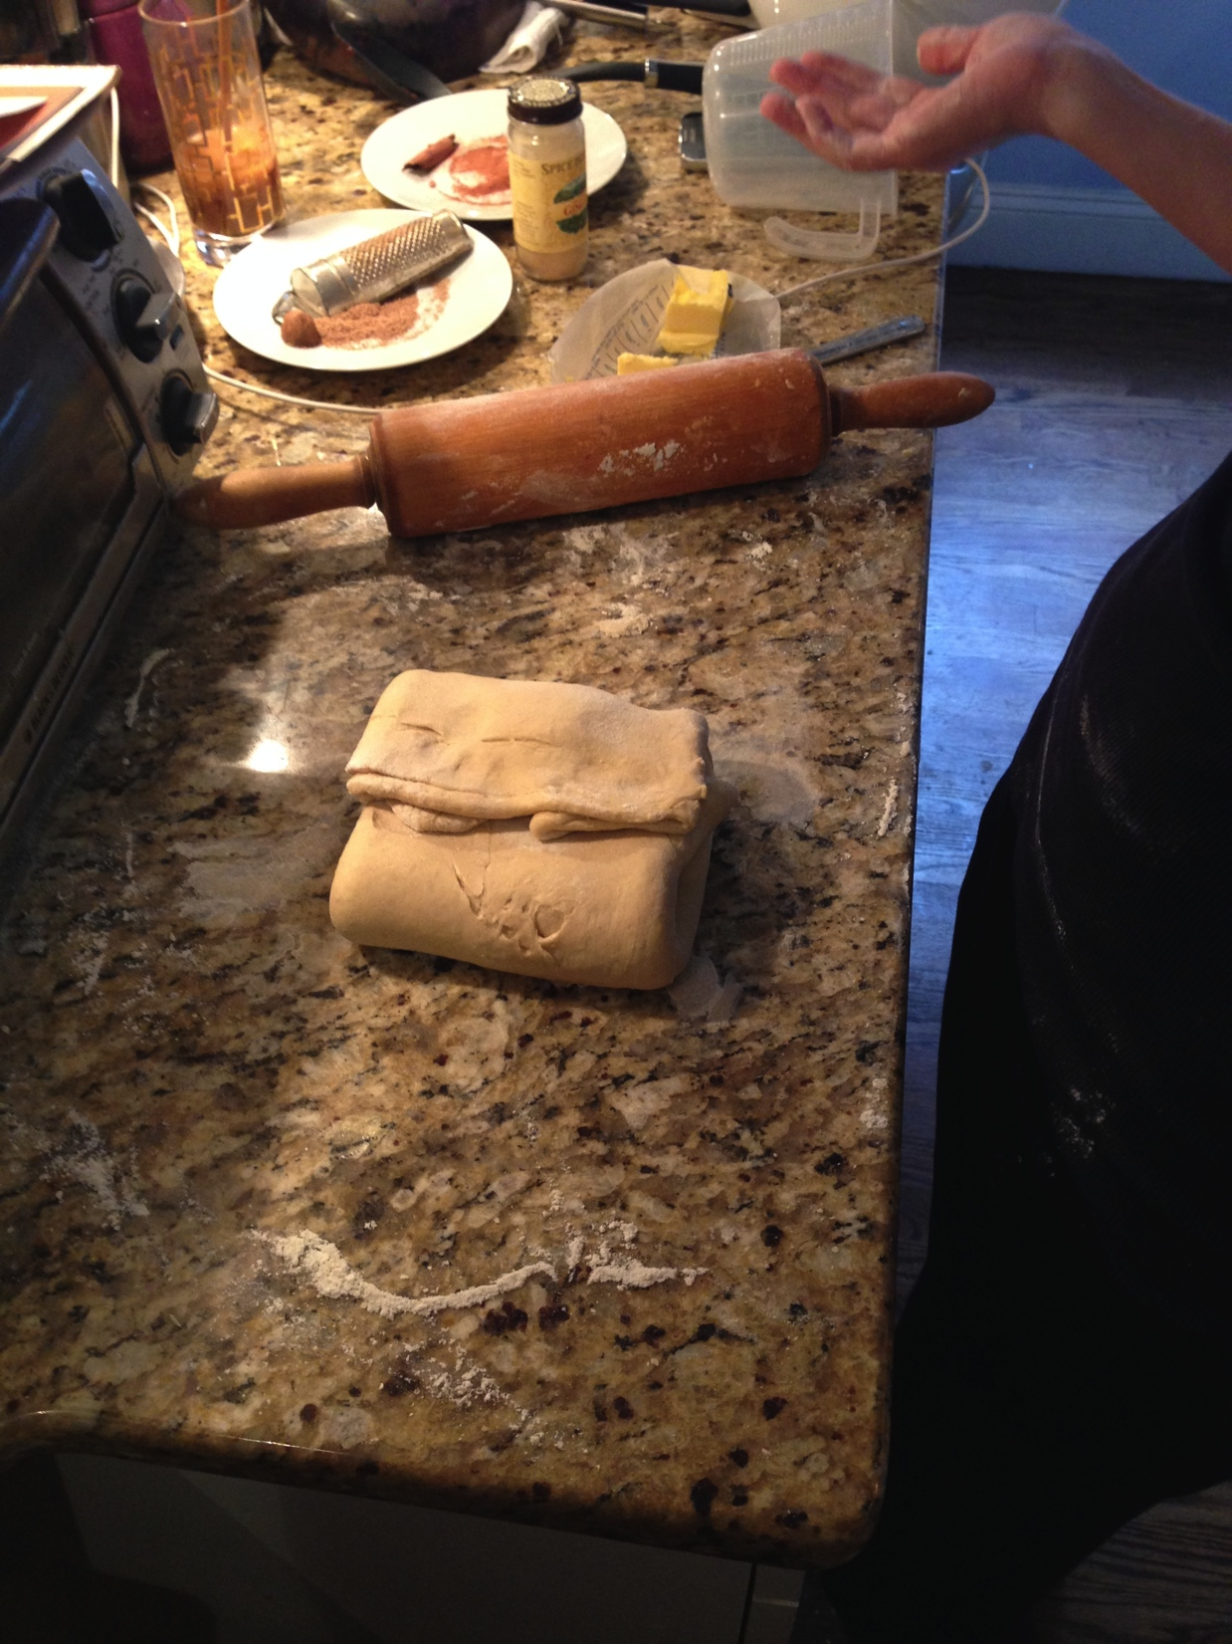
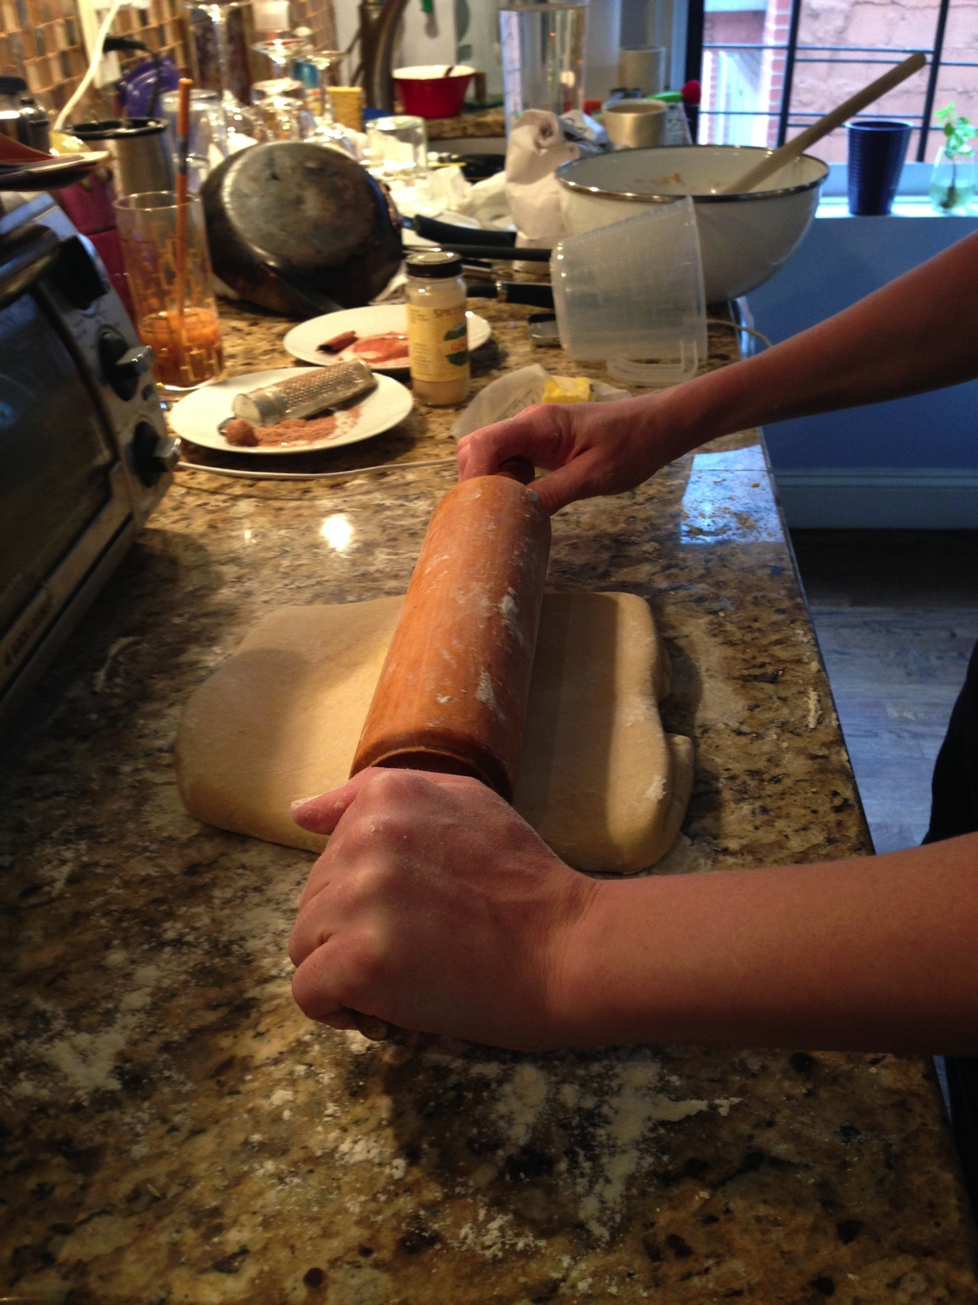
Learning Experience
Assay #1 & 2 (concurrently)
The dough was created first

Slide 15
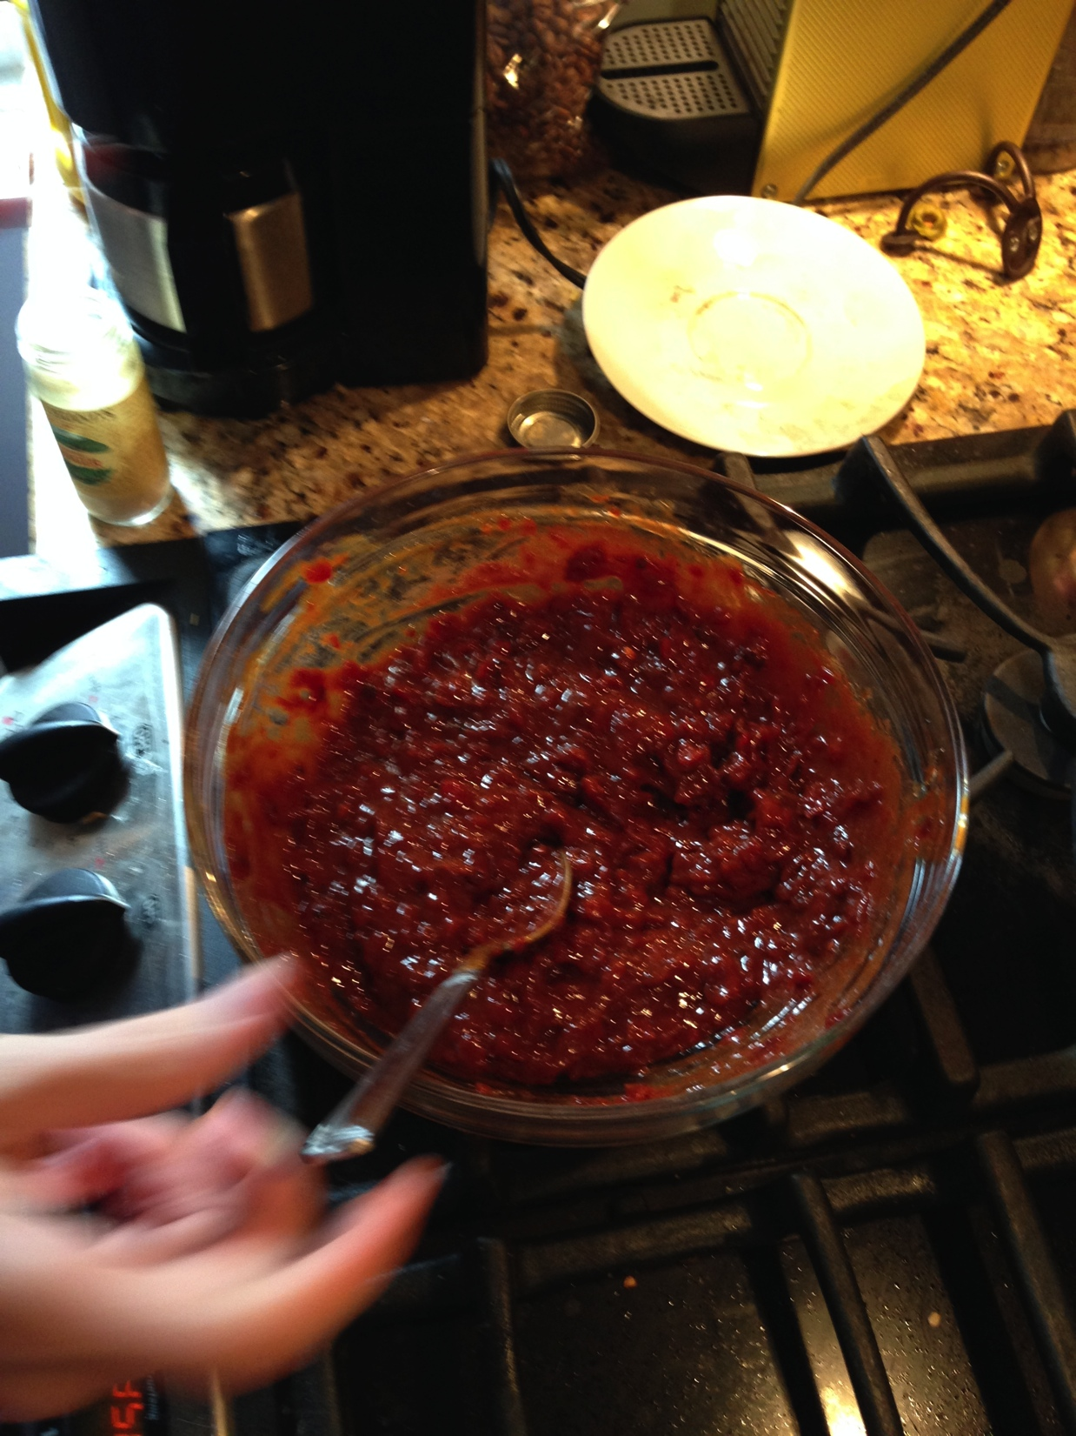
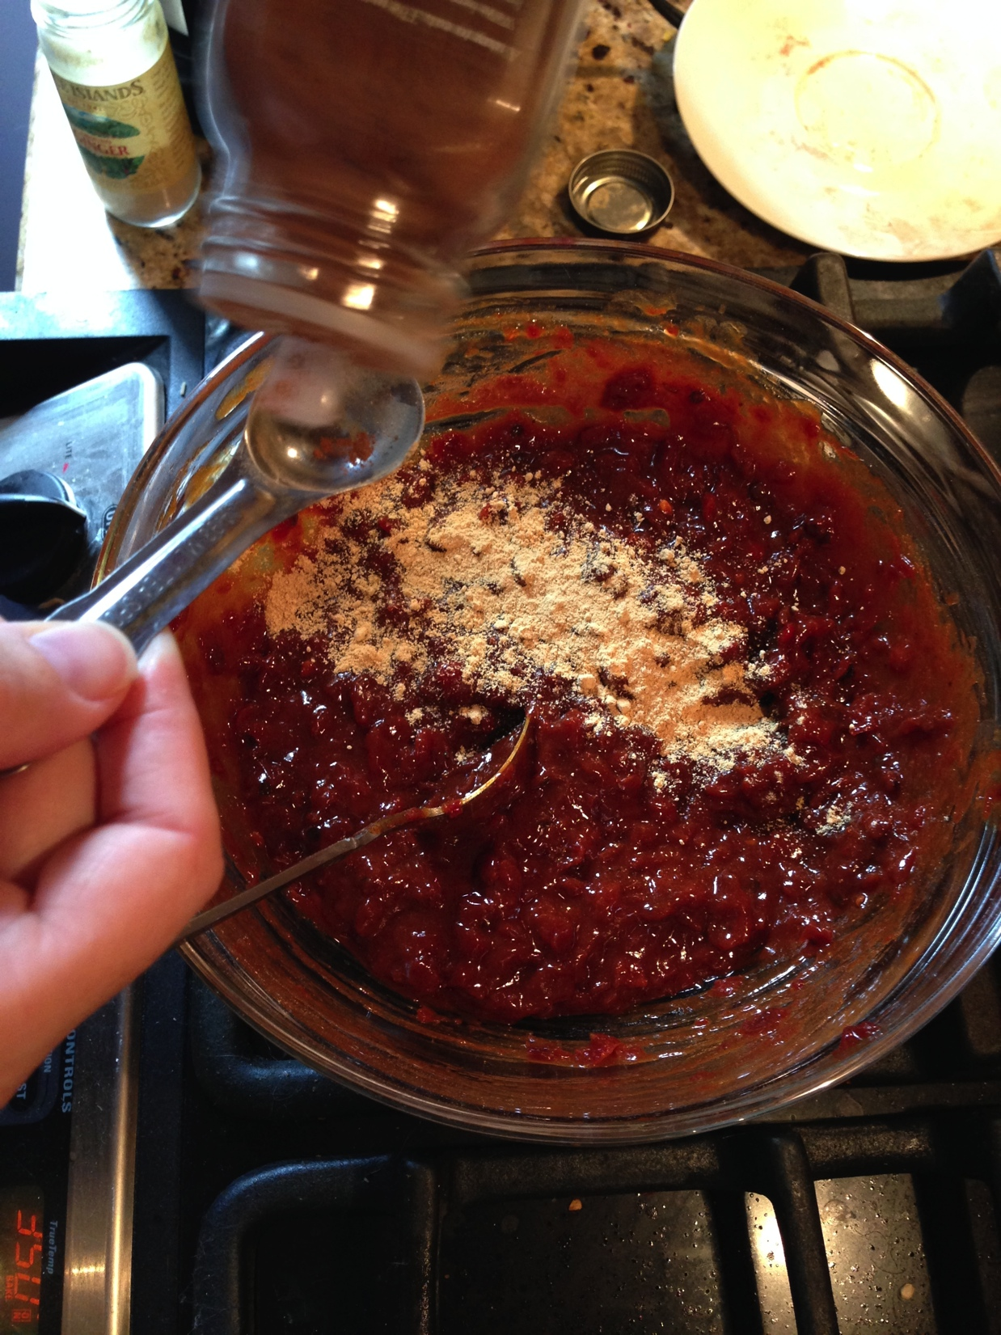
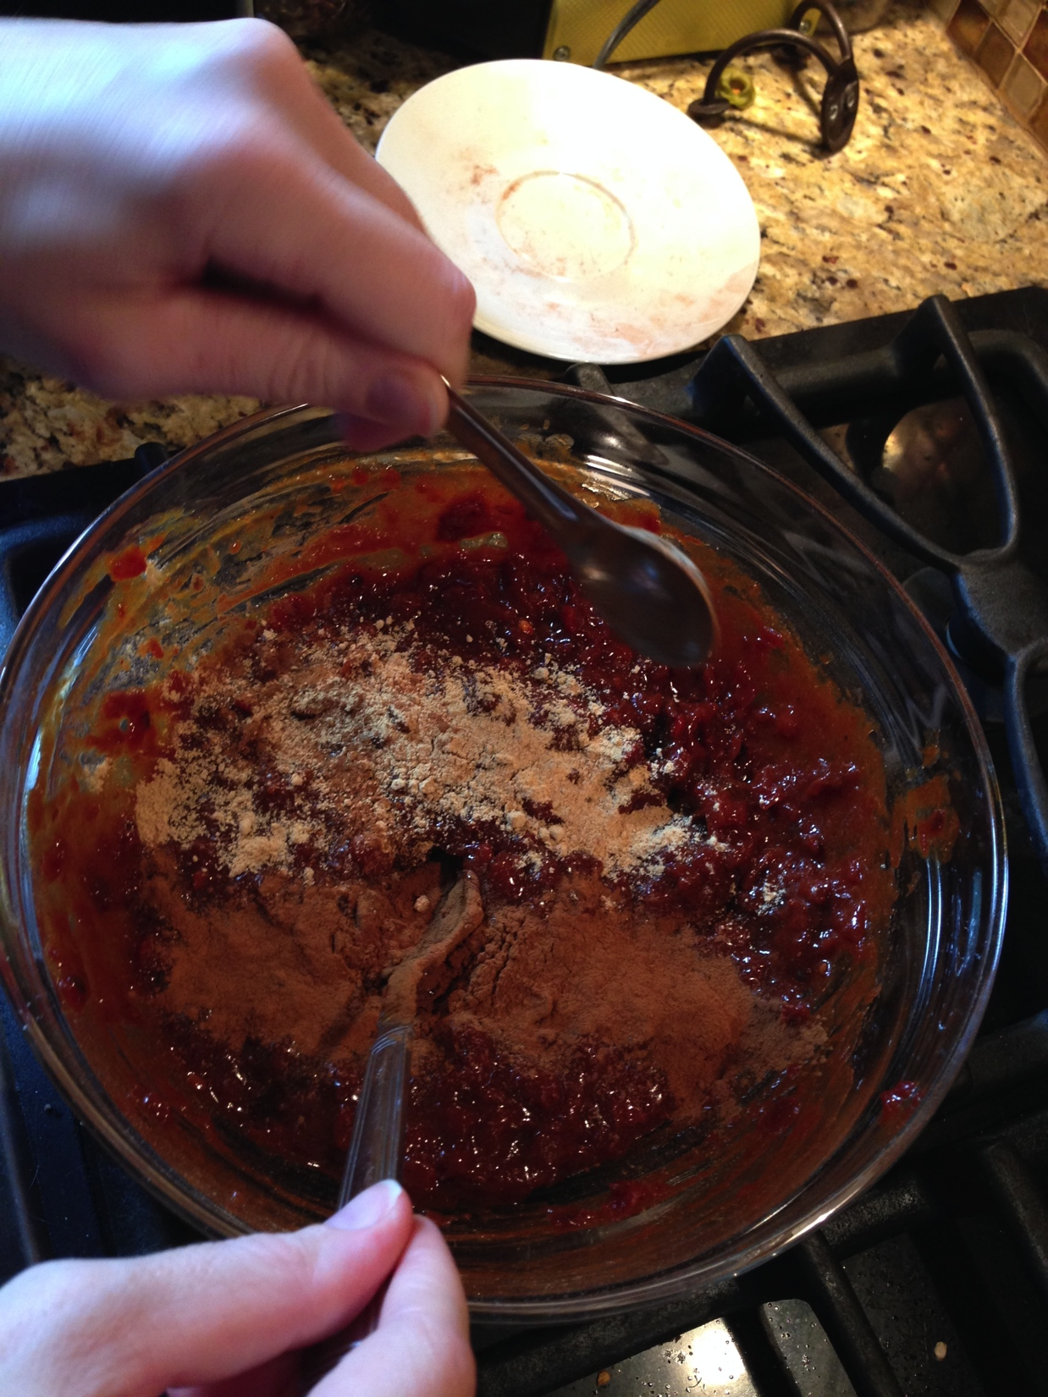
Learning Experience
Assay #1 & 2 (continued)
The jelly was then created

Slide 16
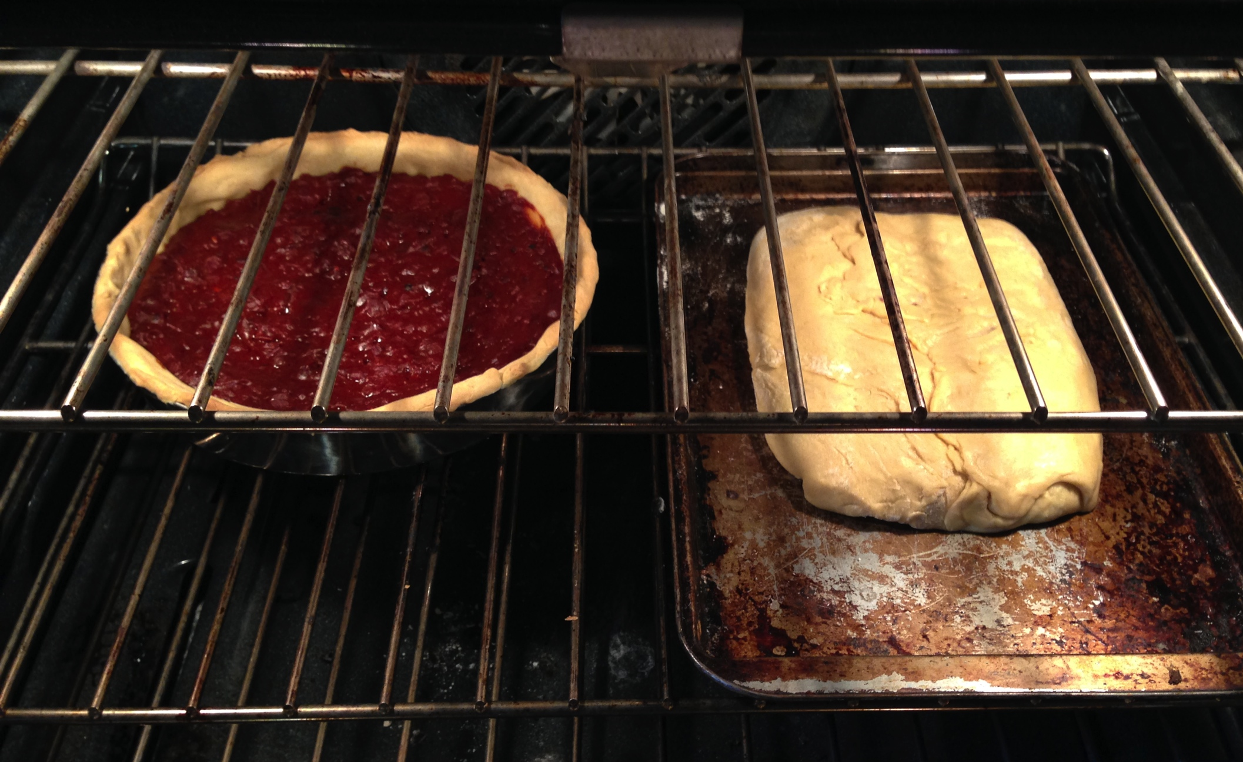
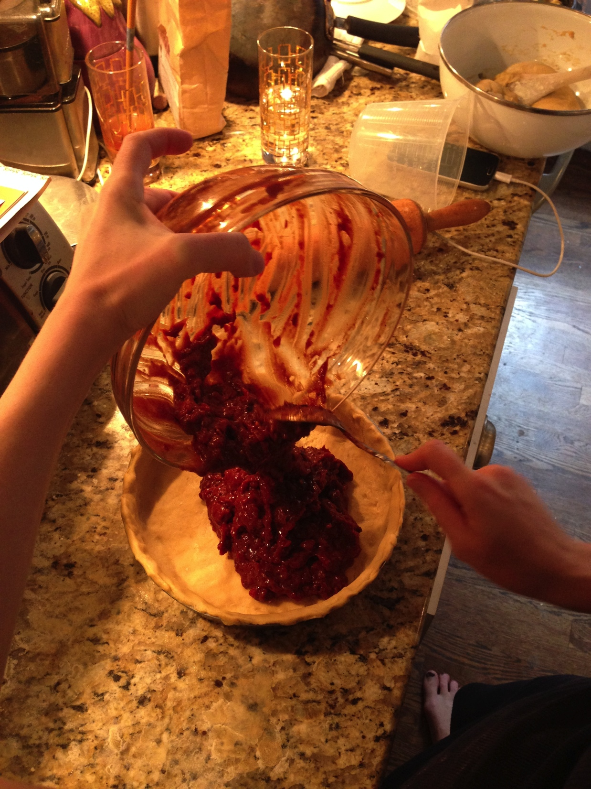
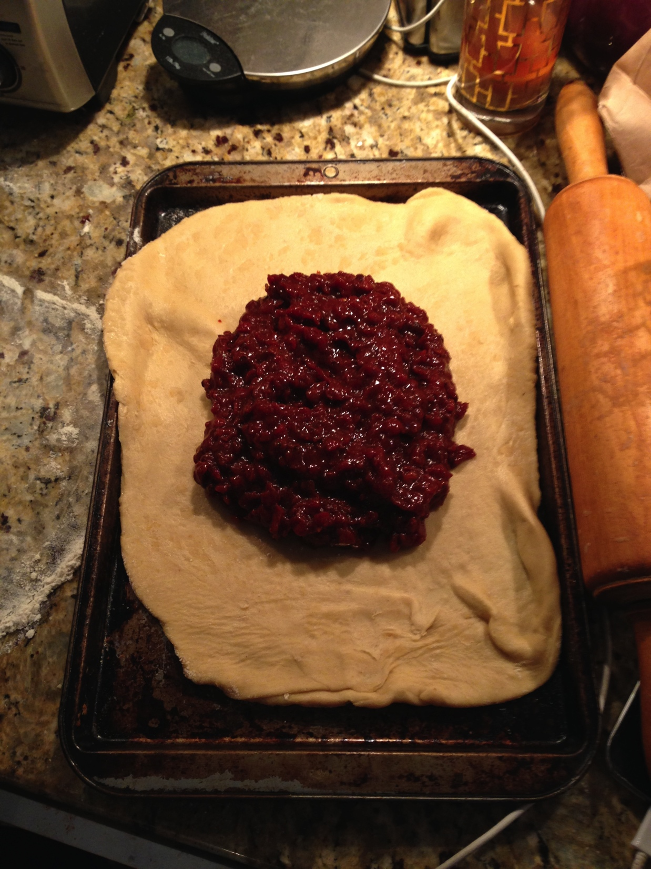
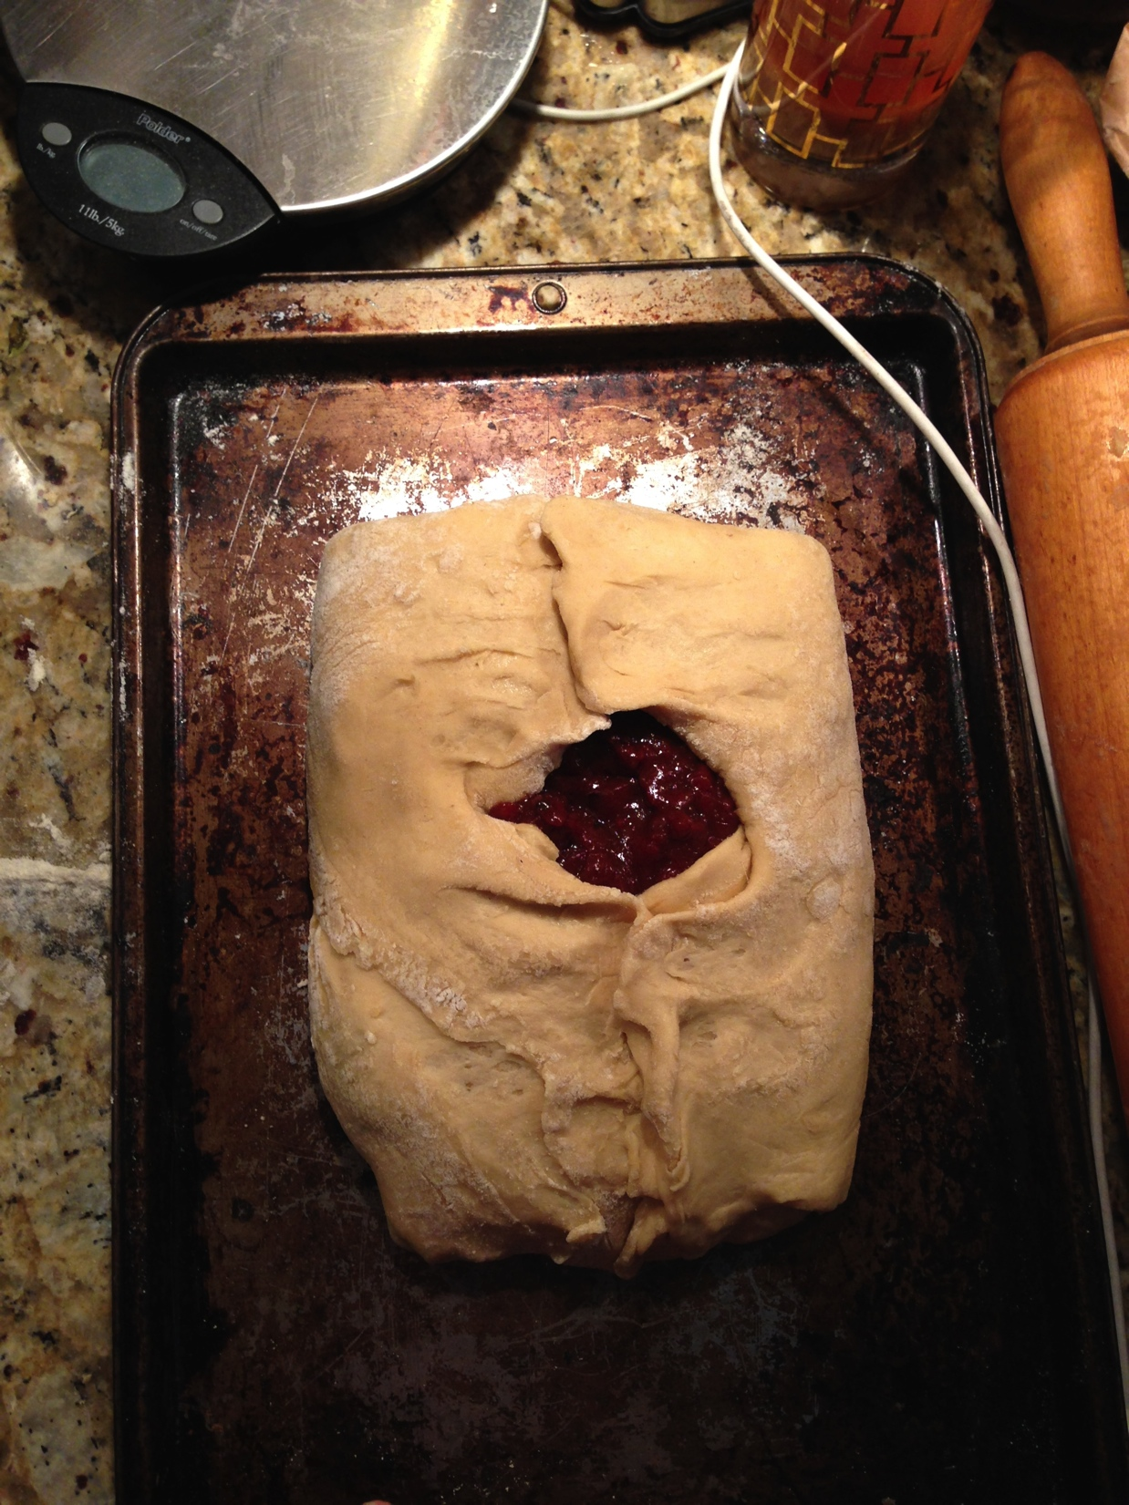
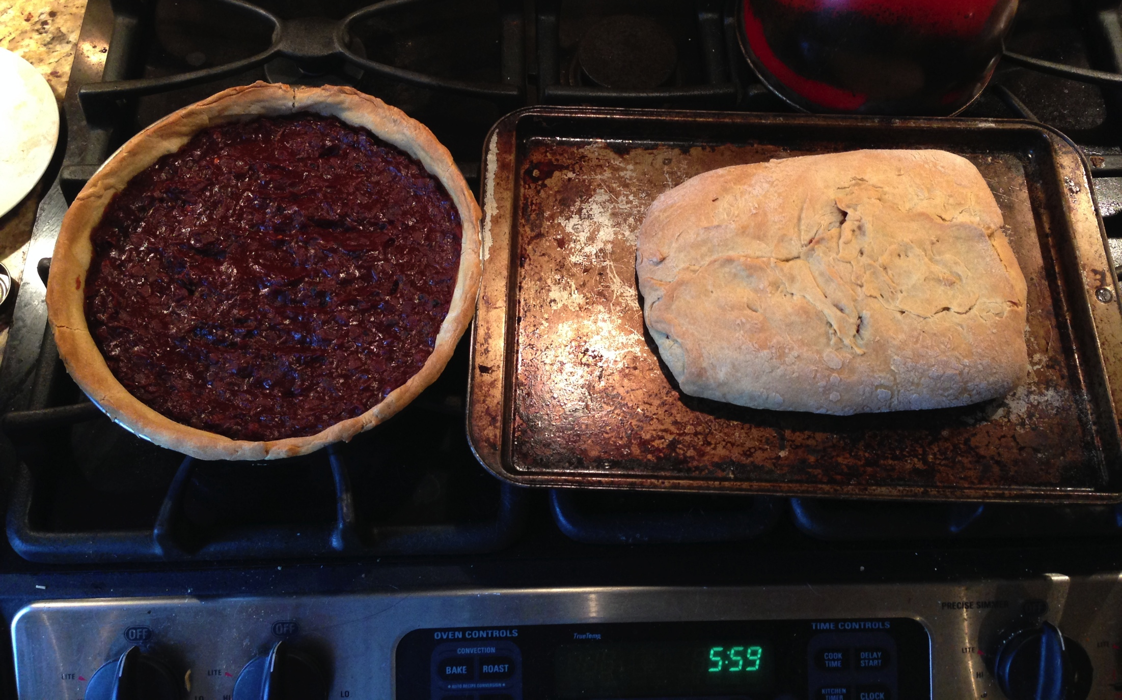
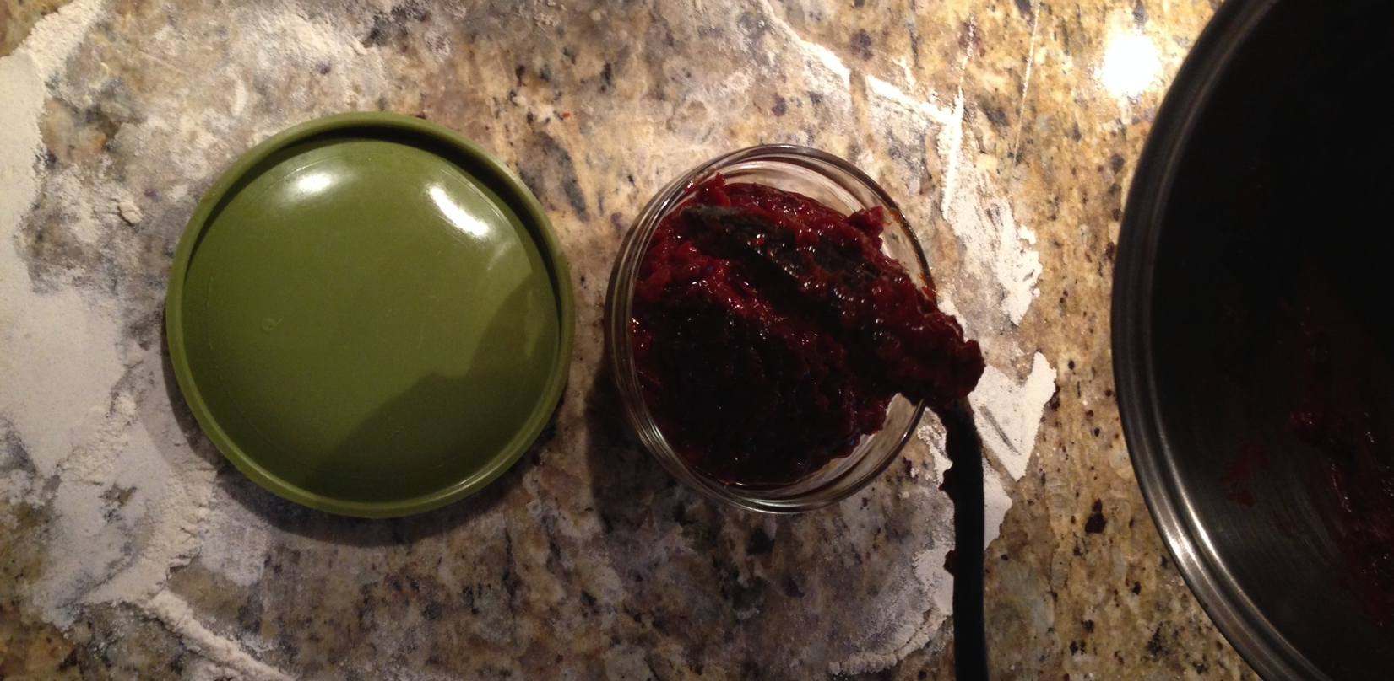
Learning Experience
Assay #1 & 2 (continued)
Baking and preserving

Slide 17
Recipe Update
Our new recipe: Rosehip Tart Two Ways
Equipment:
Bowl
Measuring cup and spoons
Pie/Tart tin
Rolling Pin
Countertop
Mixing Spoon
Butter Knife
Cookie Sheet
Oven
Ingredients:
4 cups of flour (plus extra for the rolling process)
Three egg whites
Two egg yolks
1 cup water
1.5 sticks (3/4 c.) cold butter
1 lb dried rosehips (plus water for reconstituting them)
1 and 1/3 cupd of granulated white sugar
6 tsp. ground cinnamon
6 tsp. ground ginger

Slide 18
Recipe Update
For the filling:
Take dried rosehips and pour boiling water over them in a pot on the stove - just enough to cover.
Turn the burner on and heat until boiling.
Stir frequently until water begins to be absorbed by the hips.
Continue heating at a low boil and adding more water regularly until the hips begin to soften and turn into an edible goop.
Add sugar and spices and mix into the hip goop. Scoop filling into crust as described in either method above.

Slide 19
Recipe Update
For the dough: (1)
In a large bowl, mix flour with eggs, adding water as necessary until it has a gummy, tacky consistency (like biscuit dough).
Lightly flour your rolling surface and place dough on floured area, covering dough and rolling pin with extra flour so that it does not stick to the dough.
Roll dough until it's between 1/8 inch and 1/4 inch thick.
Using a knife, cut small pieces of butter (about the size of a shelled hazelnut) and drop them evenly across the surface of the dough.
Fold up the dough, encompassing the butter pieces inside the folds, and re-flour and re-roll the dough.
Repeat the above two steps a total of 10 times.
Divide the dough in half. Roll one 1/2 of the dough out again, thinner than previously, and drape it over your pie tin/tart tin until it is covered. Trim excess from sides and reserve for future use.
Add filling and bake, open-faced, at 350 degrees for 35-40 minutes.
For the dough: (2)
Roll out the second 1/2 of the dough, more thick than the portion you used for the tart pan, and place on a cookie sheet.
Spoon filling onto the dough but leave enough of a border around the outside that you will be able to just cover the top of the filling.
Fold the sides of the dough over the filling so that the filling is completely enclosed like a Beef Wellington.
Bake at 350 degrees for 50 minutes.

Slide 20
Conclusions
So what? What did we learn by preforming this reconstruction?
Road to ruin is paved with good intention and refrigerators;
Honing our attention to detail is essential to executing the recipe successfully. The mysterious addition of nutmeg shows that human memory, action, and planning are completely fallible and sometimes illogical;
The process to cook a tart involved a rather labor intensive process. Preparation of the materials needed requires a lot of prior planning and foresight.
Cooks of the EME were expected to use a wealth of personal judgment when it came to creating dishes from the literature provided. Some prior experience or supplemental knowledge was required to adequately complete the task of making a tart.

