Slide 1
Recipe Reconstruction
A Syrupe to coole the Stomake and to allaye Choller
Wellcome Library Ms. 213
Mrs. Corlyon Recipes for Syrups, 1606

Slide 3
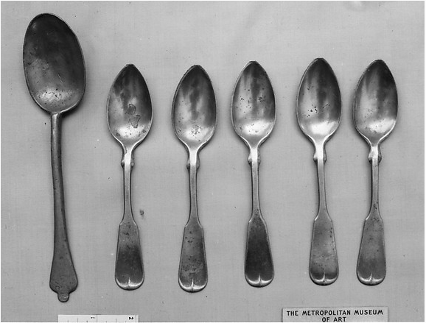
Before Cooking: Research
Choller:
“A humor causing anger”
(Robert Cawdrey, A Table Alphabetical 1604; Lexicons of Early Modern English)
“The bile. By the superabundance of this fluid, anger was formerly supposed to be produced; or perhaps the opinion was that the bile caused the inflamed appearance of the face in anger.” Also: anger, wrath, irritations of the passion. (Webster’s Dictionary 1828)
Spoonefulles
17th century pewter / metmuseum.org

Slide 4
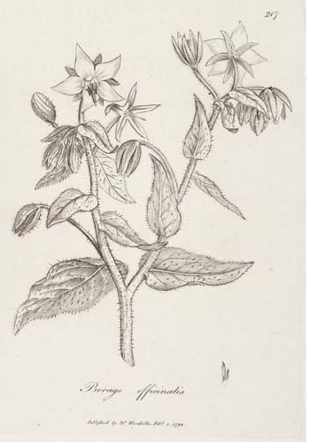
Before Cooking: Research
Oranges, lemons, pomegranates
From seventeenth Santiago, Portugal: “Here are great plenty Oranges which are large and very sweet, aboundance Limes, and many Leamons, all which are very cheape, which at our first going a shore might be bought for little peeces of old ribbin, [sic]”
(John Marshall in India: Notes and Observations in Bengal 1668-1672, p.44)
Redd rosewater
Used since ancient times; Sassanid Persian roots of flower cultivation; medieval Persian polymath, Avicenna, refined the process of steam distillation which is still used in modern mass production of rose water
(Iranreview.org; history-science-technology.com)
In seventeenth century Britain, the trade of vanilla started to supersede use of rose water in cooking (The Telegraph, June 2015)
Sugar
Refined sugar sold in “loaves” acted as a preservative
(Folger Shakespeare Library, “Syrup of Violets and Science” video)
Faire water:
“clean or unbroken”
(Glossary of Period Cooking Terms-Terra Pomeria)
Borrage water
made from “borage,” a “cheerful herb”
https://www.nps.gov/rowi/learn/historyculture/colonial-kitchen-garden.htm
Botanical.com

Slide 5
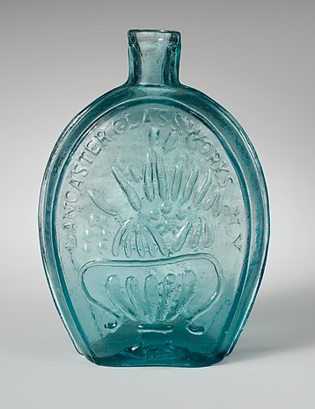
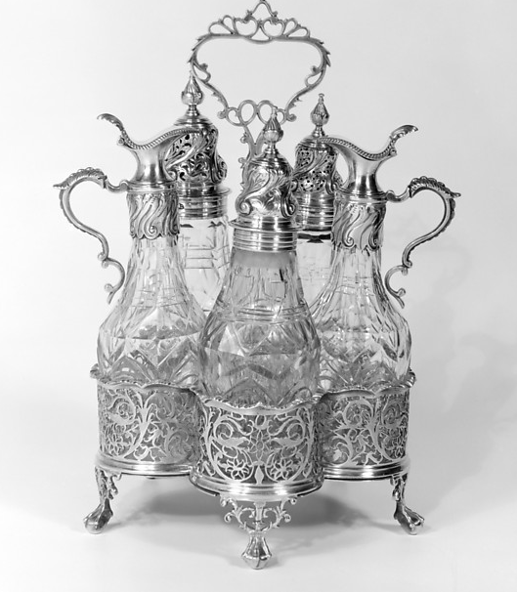
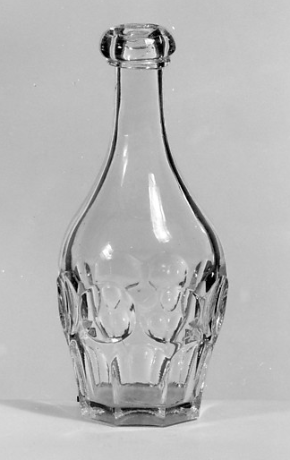
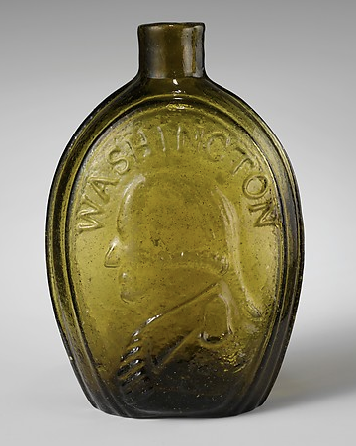
Glassware
18th century British glass
19th century pint flask
19th century half-pint
In the seventeenth century, English glass houses made glass more brilliant by adding lead oxide (Corning Museum of Glass)
17th century French
19th century pint flask

Slide 6
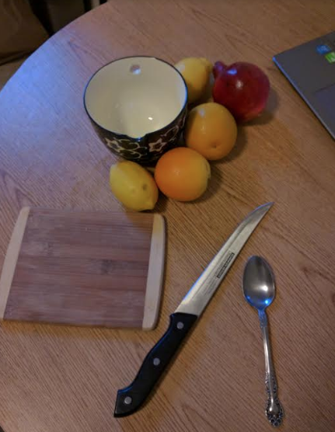
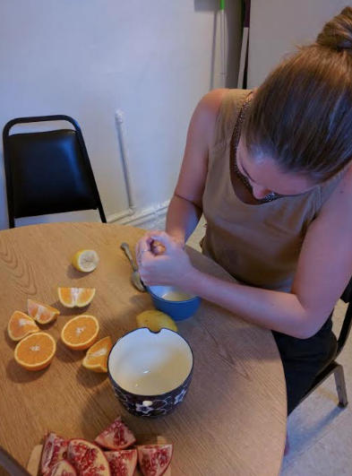
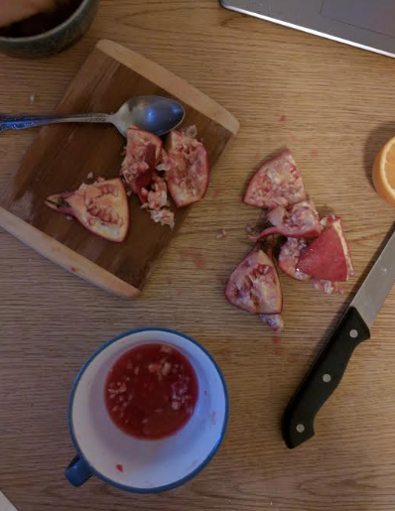
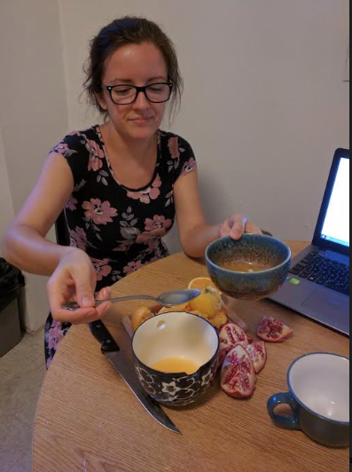
Cooking Process
Juice oranges, pomegranates, lemons
Need six spoonfulles of each

Slide 7
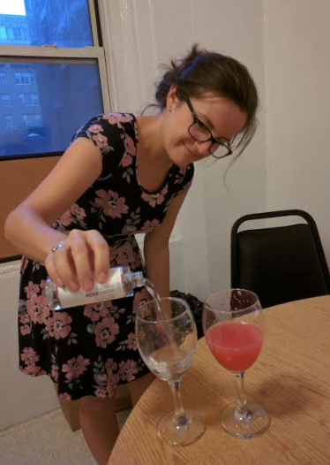
Cooking Process
Add rose water equal to juice

Slide 8
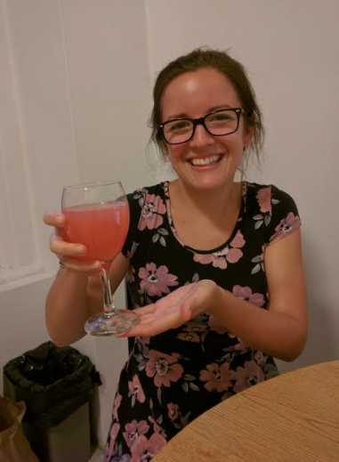
Cooking Process
Add faire water equal to juice + rose water

Slide 9
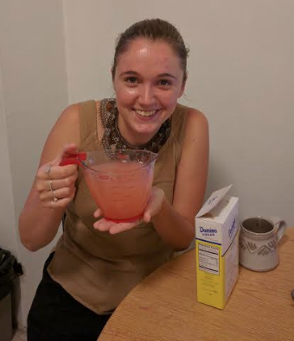
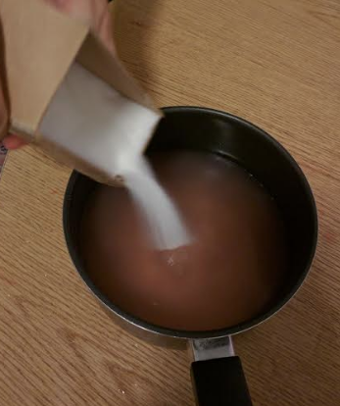
Cooking Process
Add ½ pound of sugar to every half pint of mixture

Slide 10
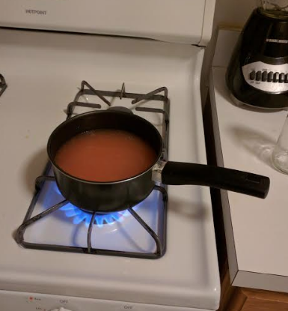
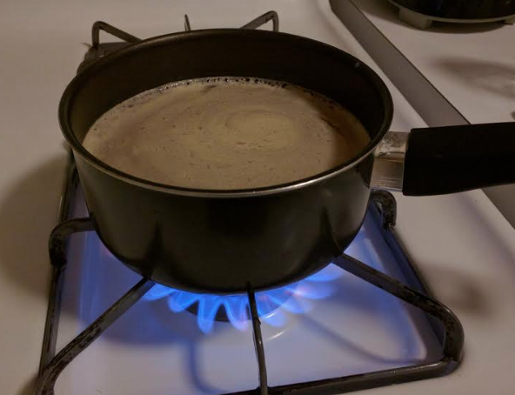
Cooking Process
Boil mixture until it becomes a syrup

Slide 11
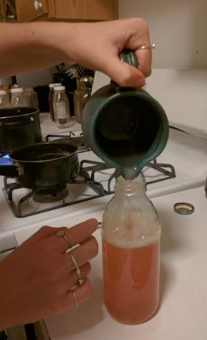
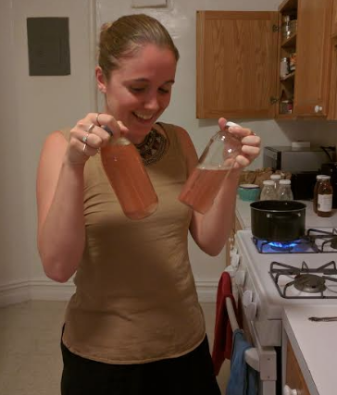
Cooking Process
Put the mixture in a glass container to store until used

Slide 12
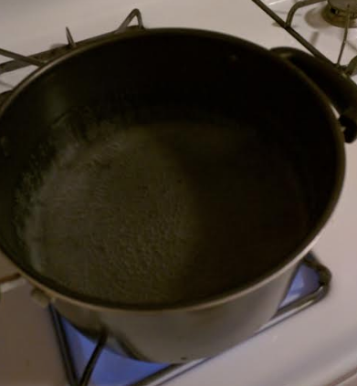
Cooking Process
When about to use some of the syrup, boil the equivalent amount of borrage water or faire water or rose water and mingle it with the syrup before drinking

Slide 13
A Syrup to cool the stomach and to allay anger
Take six spoonfuls of orange juice, six spoonfuls of lemon juice, and six spoonfuls of pomegranate juice (if you can get it)
Add as much rose water as you have juice
Add water equal to the juice and rosewater mixture
Measure this mixture
Add ½ a pound of sugar for every half pint of mixture
Boil mixture until it becomes a syrup
Put into glass container to store until used
When about to drink some of the syrup, boil the equivalent amount of borage water or clean water or rose water and mix it with the syrup before drinking

