Slide 1
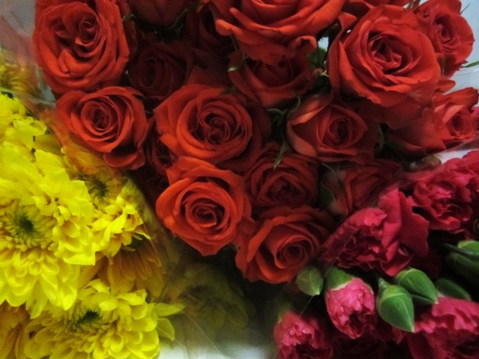
Experiments in Sugar-works To make a paste of Flowers and Colour of Marble, that which way soever you break it, it shall be like Marble, and betwext the light, it shall look very clear, and shall in eating taste of natural flowers. (Or not.)
Teresa Soley and Njeri Ndungu
Craft and Science in the Early Modern World
Home Culinary Reconstruction
30 January 2016

Slide 2
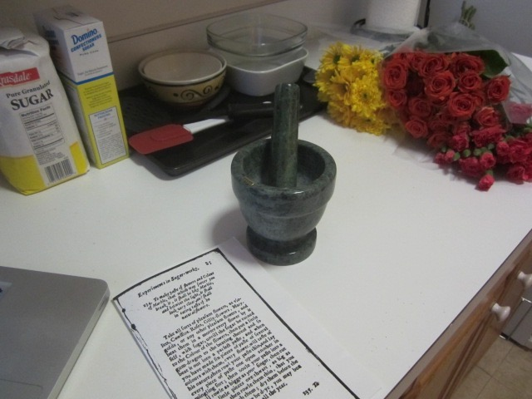
Ingredients and tools
Notes:
STARTING OUT

Slide 3
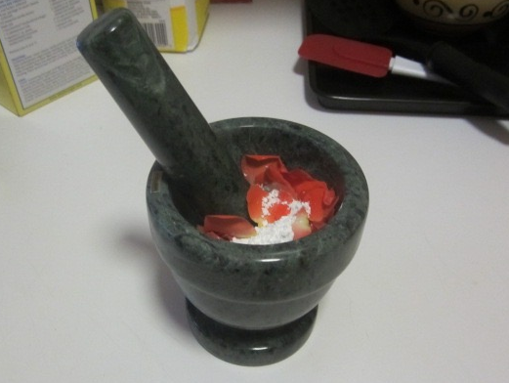
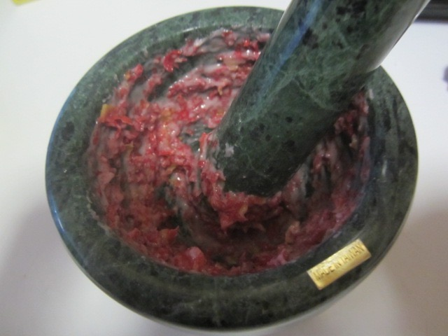
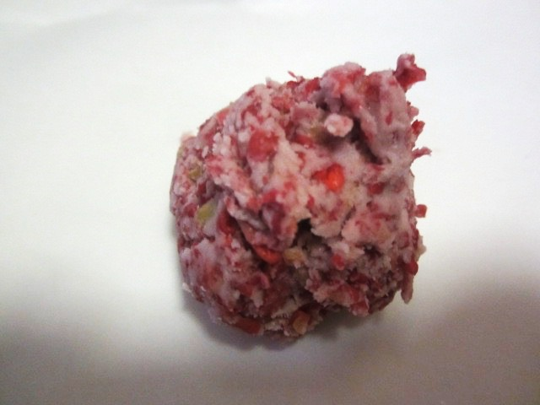
Notes:
PROCESS

Slide 4
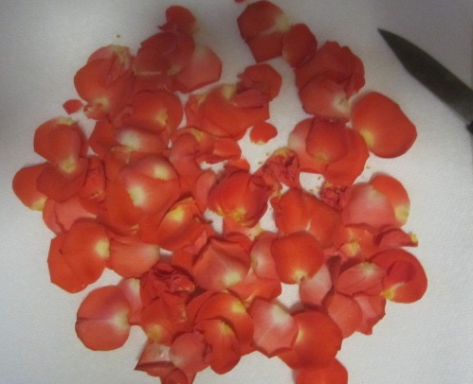
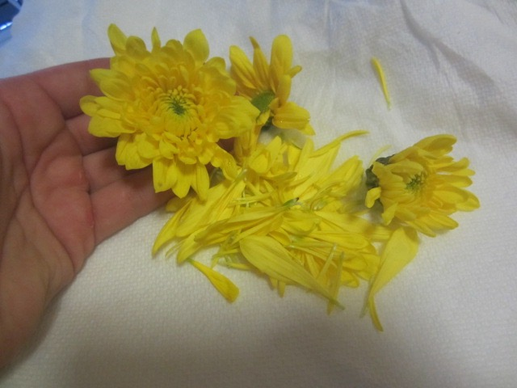
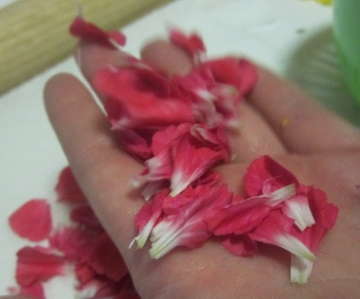
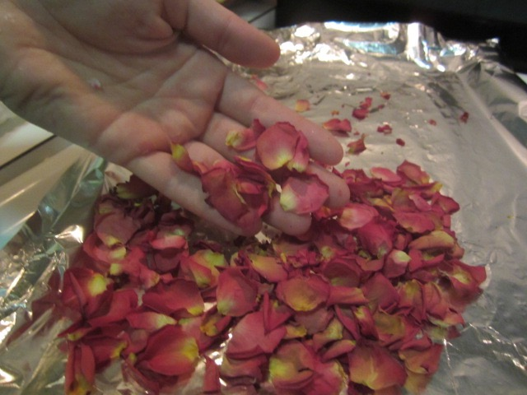
Good
Bad
Good
Bad
Notes:
INGREDIENT COMPARISON

Slide 5
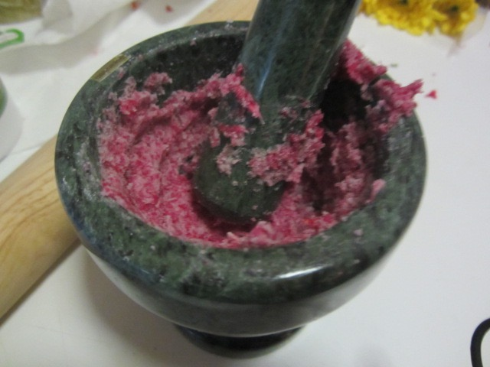
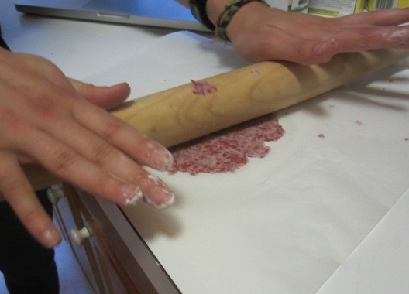
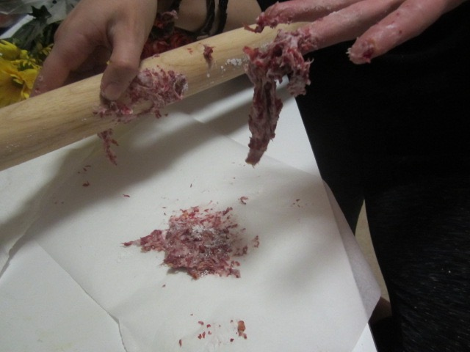
Guar gum
Xanthan Gum
Notes:
GUM COMPARISON

Slide 6
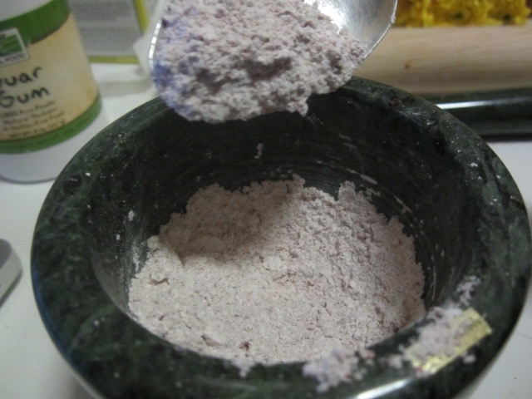
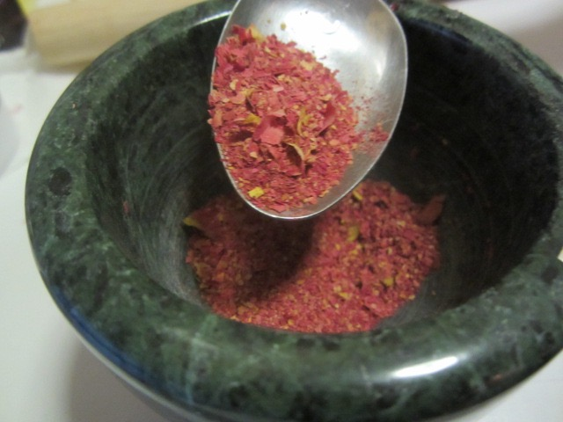
Experimenting with dry flowers

Slide 7
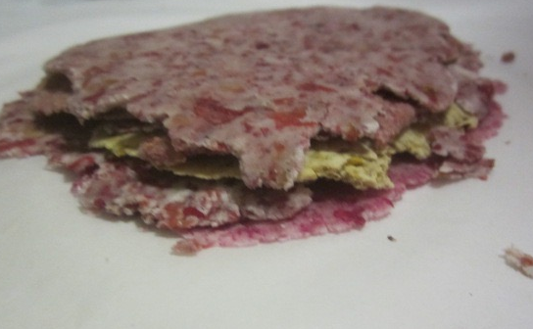
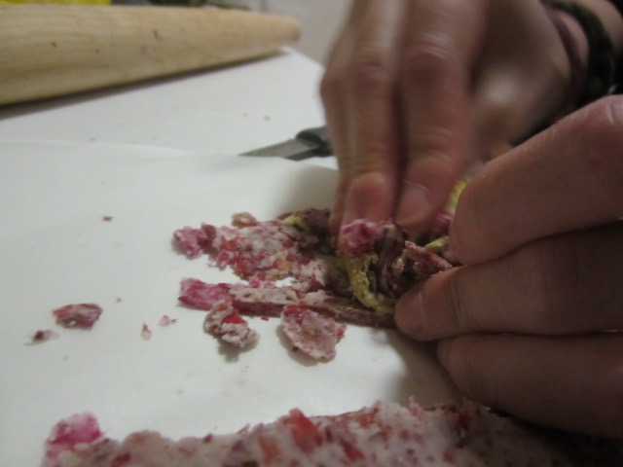
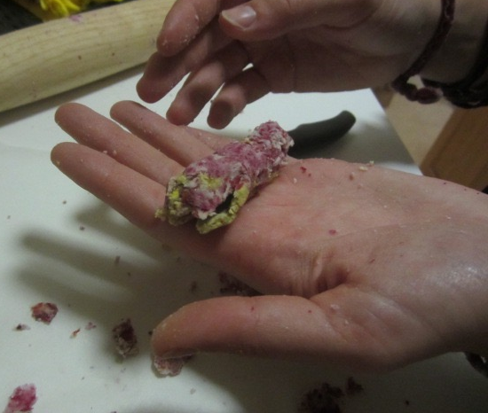
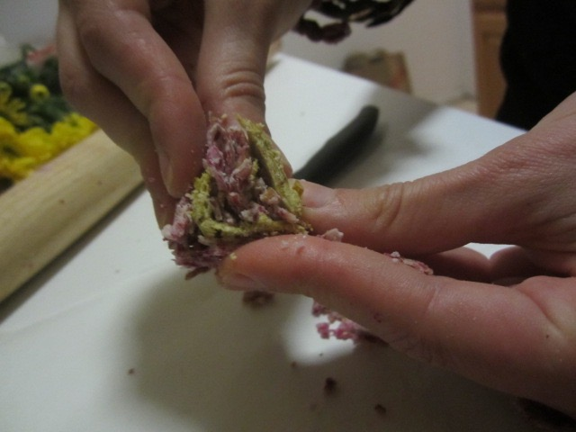
Notes:
FINAL STAGES // EPIC FAILS

Slide 8
