Slide 1
Cultures of Innovation in craft handloom weaving
Annapurna Mamidipudi
Maastricht University
October 2014

Slide 2
The handloom project
The handloom project: relevance
Adapting reactive dyes
Inventing natural dyes
Remembering indigo
Notes:
Tale of cities

Slide 3
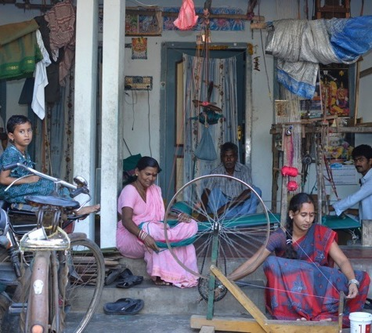
Handloom weaving in India
4.3 million weaver families
Second largest rural livelihood after agriculture
6.9 billion square meters of fabric

Slide 4
Textile Industry in India
Parallel technological ensembles
Mill 3%
Power loom and Hosiery 86%
Handloom 10%
Khadi 1%
Differentiated by levels of mechanization
Different organizational and social relations

Slide 5
Industry in Crisis
47% below poverty line
Livelihoods: Welfare rather than market driven
Technology: Static rather than innovative
Product: Charity rather than value
Weaver: Invisible except when in crisis
Therefore handloom is unsustainable!

Slide 6
The marketing program-DAMA
The reactive dyes program- Handloom Co-operatives
Wholesale-retail experience-Daram
Designer weaver
Next round of solutions?
Upscale
Mechanise
Modernise
Educate
………the obduracy of the handloom discourse
Notes:
Show the squabbling…what set of assumptions, what are the doubts and skepticsms they generate

Slide 7
The handloom project
How can handloom claim to be technology, when the loom is static?
How can handloom livelihoods be sustainable, when weavers themselves leave weaving?
How can handloom products be re-designed for new markets, when weavers refuse to change their mindset?
How will handloom survive, when it does not innovate?

Slide 8
The socio-technical ensemble
spinning
MOBILE PHONE
Internet
dyeing
Warping drum
Sizing shed
Loom
Yarn trader
dyer
warper
sizer
weaver
Weaver-trader
designer
retailer
customer

Slide 9
Three changes in colour
Adapting reactive dye technology
Inclusion in the technological frame of handloom [Standardisation, ‘skill’ifying] [Bijker]
Re-inventing natural dye technology
‘pidgin’ recipes in the handloom ensemble [interactional expertise] [Collins]
Redeeming Indigo dye technology
Somatic expertise and materiality [Transmission of knowledge through memory practices] [Bowker]
Notes:
Interactional experts as translators, managing multiple pasts with contiuity and overlap

Slide 10
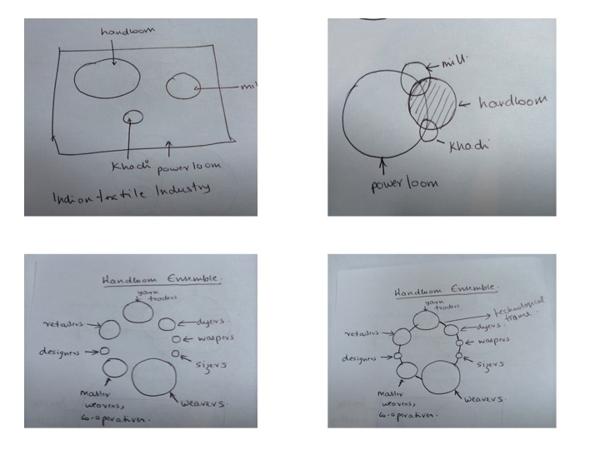
Reactive dyeing skills: Inclusion in the technological frame
Notes:
What binds them together….skill…inclusion

Slide 11
Natural dye technology
Different kinds of expert groups: The driver, the housewife and the engineer
Spaces of negotiation:
Bus rides
How to write a recipe [scientific/craft]
Authenticity of practice
Notes:
Tacit practice knowledge into explicit instructions back to tacit practice [writing for who?] no action at a distance

Slide 12
Remembering indigo

Slide 13
Indigo
Remembering colour
Smelling colour [saudu matti]
Knowing colour [pachchi gaddi thinna gorre penda, chandrakali cheera]
Multiplicity of memory practices: embodied craft, oral transmission, written archive, electronic database
Notes:
Speciality is not that it is oral etc, but that it is craft…

Slide 16
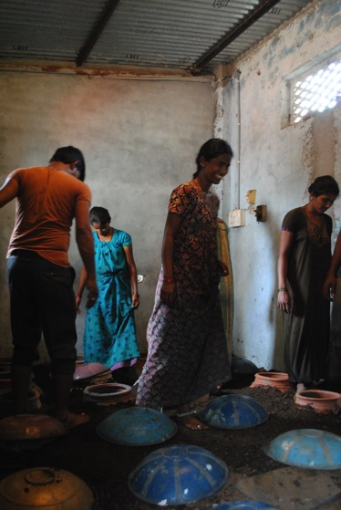

Slide 21
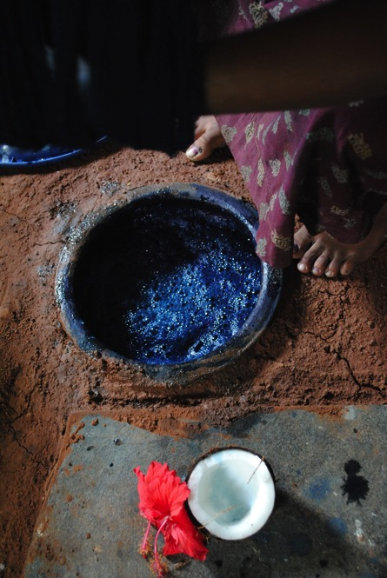

Slide 22
‘Ordering’ socio-technical practices
Standardization and skillifying
Market, production and interoperability
2. Interaction
Interactional expertise [speaking ‘Weaver’]
3. Craft knowledge as memory practice
Conserving and transmitting somatic and material knowledge
Notes:
Community, unique adequecy ethno methodology

Slide 23
Culture of Innovation: Recasting innovation as tradition
The positive value of Continuity
“Traditional Uppada Jamdani”
The negative value of Innovation in traditional crafts
“Why do we need to innovate on a classic?”

Slide 24
…shift to creativity

Slide 25
The case of Karnatic music
Traditional Practices/Craft that comes before creativity
Building skill through repetition
Learning rules through imitation
Becoming fluent through variation
Performance…..creates uncertainty

Slide 26
The ‘Divine Bliss’ of creativity
Requires leaps of faith
The importance of the Guru
The moment of creativity: Experienced as the absence of self

Slide 27
The case of Science
Building skill through practice (Hayes 1989)
Learning heuristics through imitation (Dunbar 1995)
Fluency and flexibility (Guilford 1950)
Problem solving: Testing for creative ability (Weisberg, Reeves 2013)

Slide 28
The Eureka! Moment of creativity
Leap of insight (Akin and Akin 1996, Ohlsson 2011)
Supervision by teacher (Ericsson, Roring and Nandagopal 2007)
The moment of creativity: experienced as unconscious creative process (Csikszentmihalyi 1996)
….. the AHA! Experience of innovation

Slide 29
Importance of craft in innovation
In Music and in Science
First build craft through practice
Innovation is accompanied by leap of faith/unconscious process
…acquiring Craft through Practice and Imitation is important precursor to Innovation

Slide 30
Can there be innovation without craft?
(in handloom or in science or in music)

