Slide 1
Bread Molding Reconstruction
By Emily Boyd and Jef Palframan
Assignment #2
HIST G8906 – Craft and Science

Slide 2
Purpose of the experiment
Purpose of this Experiment:
To reconstruction of Early Modern (EM) bread molding techniques, in order to:
Establish a family of related recipes for bread molding;
Approach an understanding of EM materials and their properties;
Develop and refine procedure for conducting reconstructions from historical recipes;
Gain more hands-on experience with reconstruction techniques; and
Improve the capture/reporting of techniques and findings.

Slide 3
Establishing Context: the Recipe and supporting knowledge
Primary Recipe:
The primary recipe for the experiment was ‘To cast in sulfur’ on p140v of BnF Ms. Fr. 640.
Supplemental Recipes and Sources used as Guidance:
Molding and reducing a big piece (p140v), Stucco for moldings (p029r), Box mold (p082r), Molding sulfur (p012r);
Biringuccio - The Pirotechnia:
The methods of Moulding Various Kinds of Reliefs, p. 329-331.
Cellini - The Treatises of Benvenuto Cellini on Goldsmithing and Sculpture:
How the above mentioned clay is made, p. 113.
May, Robert - The Accomplisht Cook, or the Art and Mystery of Cookery:
To make French Bread the best way, p. 239 (Courtesy of the research of Dr. Bilak).
Theophilus - On Divers Arts:
Chapter 33. The Rinds of Folium and Their Tempering Media, loc. 1012.
Modern day recipes found at the following sites:
http://www.thekitchn.com/how-to-make-your-own-sourdough-starter-cooking-lessons-from-the-kitchn-47337
http://allrecipes.com/recipe/sourdough-starter/
http://allrecipes.com/Recipe/Sourdough-Rye/Detail.aspx?event8=1&prop24=SR_Thumb&e11=sourdough&e8=Quick%20Search&event10=1&e7=Home%20Page&soid=sr_results_p1i5
http://www.kingarthurflour.com/recipes/rustic-sourdough-bread-recipe

Slide 4
Establishing Context: The recipe and language
To cast in sulfur - p140v:
To make a clean cast in sulfur, arrange the pith of some bread under the brazier, as you know how to do. Mold whatever you want & leave it to dry & you will have a very clean work./Try sulfur passed through melted wax, since it won’t catch fire & won’t make more little eyes.
Confirming Terminology and Phrasing:
‘bread’ – the ingredients of the bread are not defined, supplementary recipes will be required;
‘brazier’ – A large flat pan or tray for holding burning charcoal (OED); and
‘little eyes’ – bubbles or imperfections in the molding materials. Eliminating imperfections in materials is a common theme throughout the manuscript.

Slide 5
Establishing Context: The recipe and language
Molding and reducing a big piece - p140v:
“Mold it with the pith of the bread just out of the oven…and in drying out it will dimish & by consequence so too the medal that you have cast… The Bread straight from the oven is the best. And that which is reheated twice shrinks more…”
Stucco for Molding - p029r
“… spread your tragacanth gum and keep grinding and mingle little by little the very finely sieved flour and kneed it as it you wanted to make some bread until you reckon that is thick enough and firm like bread pastry you want to put in the oven. You can reckon when it can be stretched without breaking, and if it is not strong enough it can’t be well detached.”

Slide 6
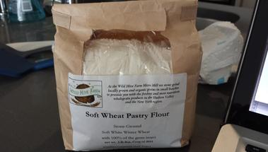
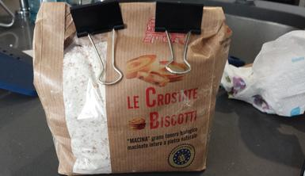
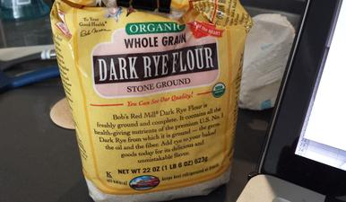
Ingredients
1st Experiment:
Water – New York tap water; and
White fine ground wheat flour (Eataly).
2nd Experiment:
Water – New York tap water;
Sourdough starter (Courtesy of Dr. Smith);
Ground Sea Salt;
Flour – 3 types:
Fine stone ground wheat (Eataly),
Whole grain wheat (Eataly),
Rye (Brooklyn Fare).

Slide 7
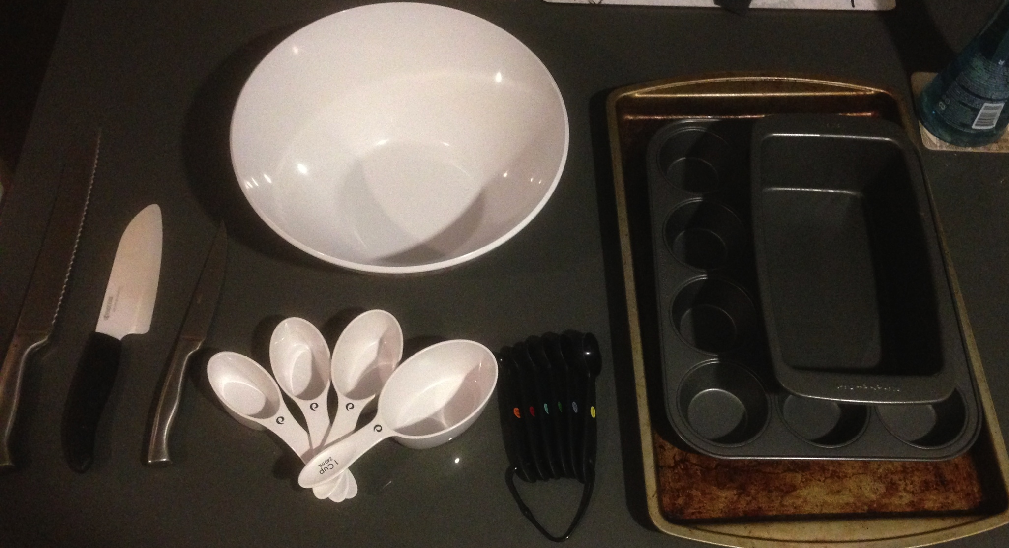
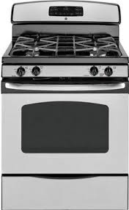
Equipment and Technologies
Preparation
plastic measuring cups; plastic measuring spoons; bamboo mixing spoon; stainless steel fork; mixing bowls, plastic - small and large;
Cooking
metal bread pan; metal tart pan; Natural gas oven.
Cutting and Pressing
Ceramic cutting knife, large;
Serrated cutting knife, small;
Serrated cutting knife, large.
Notes:
All from Opera

Slide 8
Experiments 1 & 2

Slide 9
Recipe Update
Molding with Bread:
Equipment:
mixing bowl;
measuring cups and spoons;
wooden mixing spoon;
countertop or cutting board;
spatula;
tart cooking sheet;
oven; and
the item to be cast.
Ingredients:
tap cold water – 1 cup;
finely ground wheat flour – 1 ¼ cups;
2/3 Tsp of Salt; and
1/3 sourdough starter.

Slide 10
Recipe Update
In a large bowl, vigorously mix 1 cup of cold tap water, 1 ¼ cups of flour, 2/3 Tsp of Salt, 1/3 cup of sourdough starter with a fork for 10 mins;
Place mixed dough in a pan and place in oven at 350° for 20 mins;
Remove dough from oven and cut in half to expose the ‘pith’;
Press object to be cast into the pith with enough pressure to make an impression, but not enough that the edges of the bread split;
Carefully remove the objects after two minutes; and
Casting TBD.

Slide 11
Conclusions
So what? What did we learn by preforming this reconstruction?
Road to ruin is paved with good intentions and ceramic knives (and refrigerators);
Bread molding must have been a cheap and expedient way for one to conduct moldings. The dearth of bread molding recipes in other sources is disappointing. This deficiency suggests that the practice was either not widely spread, not taken seriously by professional craftsmen, or alternative materials were reasonably available that produced just as good or better molds;
The presence of so many bread and flour-related crafting mediums in BnF Ms. Fr. 640 suggests a close relationship between the kitchen and the workshop in the EME or at the very least an open relationship between commodities and craft.

